Slide 1
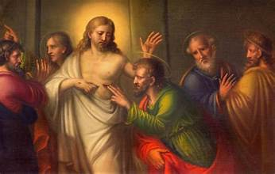
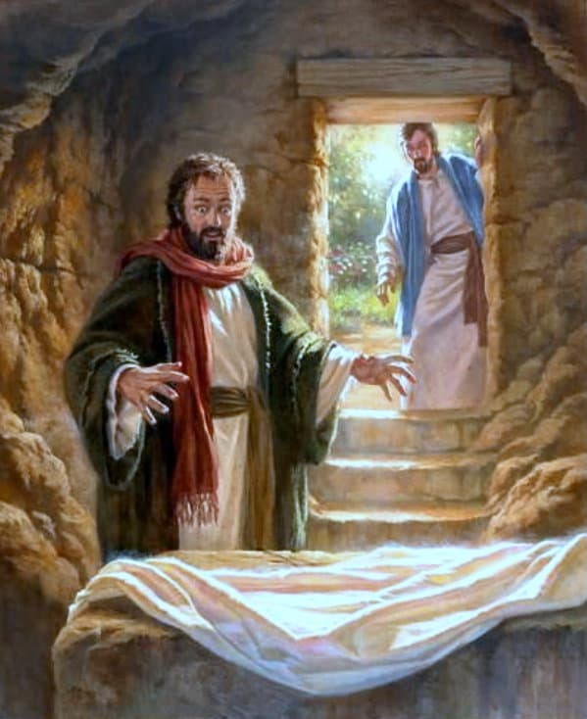
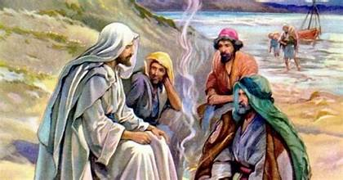
JOHN 20 – 21 The Empty tomb and post resurrection appearances

Slide 2

JOHN 20 – 21 The Empty tomb and post resurrection appearances
Notes:
Today we come to the end of our study of john and the end of our bible study for the year.
We will be looking at: The empty tomb, doubting Thomas and the post resurrection appearances

Slide 3
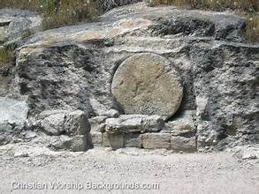
JOHN
In the beginning was the Word, and the Word was with God, and the Word was God. JN 1:1
Fulfillment of Old Testament Prophecy
7 Signs
7 I AM statements
Notes:
John is a master story teller. He knows exactly what he wants to say and knows precisely how he’s ging to get there. He wants us to believe in the divinity of Jesus.
He started at the beginning * He then shows us how Jesus is *
We have seen the * and the * Ther are many witnesses to all of this. Jesus may not be the type of messiah everyone was expecting, but everything in John is pointing to his divinity.
Except * He is now daed and lying in a tomb.
But John knows what he wants to emphasize.

Slide 4
JOHN 20
Set the scene
Series of individual stories
Purpose for this book
Who?
What type of interaction do they have with Jesus?
How do they respond?
Notes:
John starts out chapter 20 by * He then gives us *
We will be presented with actual eye witness accounts of what happened after the burial.
Within each of these stories we need to pay attention to * who is involved , what type… and how do…
And, the end of chapter 20 John also tells us *

Slide 5
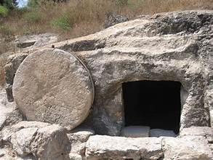
JOHN 20:1-2
Sunday
The stone is moved away from the tomb
Mary does not enter
Mary runs to Peter and the other apostle and tells them the body has been stolen
On the first day of the week, Mary of Magdala came to the tomb early in the morning, while it was still dark, and saw the stone removed from the tomb. ² So she ran and went to Simon Peter and to the other disciple whom Jesus loved, and told them, “They have taken the Lord from the tomb, and we don’t know where they put him.
Notes:
Here John sets the scene BLUE * PURPLE * DARK ** Mary runs to Pter. We can already see the primacy of Pter here.
We can also see here with the word “we” that Mary was probable not alone, but John is concentrating his story with respect to her. Mary was present at the crucifixion as an eye witness to Jesus death.

Slide 6
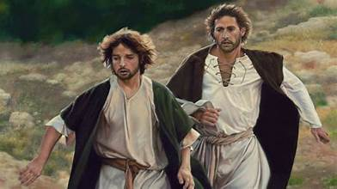
JOHN 20:3-5
3 So Peter and the other disciple went out and came to the tomb.
4 They both ran, but the other disciple ran faster than Peter and arrived at the tomb first; 5 he bent down and saw the burial cloths there, but did not go in.
John shows deference to Peter by waiting for him
John does look in and see the burial cloths.
Notes:
READ so we have the who of our first story. Peter and the other disciple – John. We know that John does not mention himself in the writing of this gospel. This was a way of writing at the time.
John being younger gets there first . So what is john thinking? * *
We see through his writing that John is observant and contemplative. The cloths are there. Jesus has not been moved. No graverobber would unwrap a corpse to take it as the cloths soaked in the perfumes would be the desired items.

Slide 7
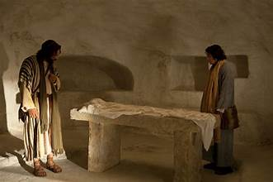
JOHN 20:6-10
What the burial cloths say:
Jesus body has not been removed with them
They have not been removed in any normal way by the person wrapped in them
They have not been removed by grave robbers or vandals
6 When Simon Peter arrived after him, he went into the tomb and saw the burial cloths there, 7 and the cloth that had covered his head, not with the burial cloths but rolled up in a separate place.
8 Then the other disciple also went in, the one who had arrived at the tomb first, and he saw and believed. 9 For they did not yet understand the scripture that he had to rise from the dead. 10 Then the disciples returned home.
Notes:
READ We see here Peter the action oriented impulsive disciple. Nothing will stop him from entering the tomb right away.
The image we get of the burial clothes is that they are ordered. The clothes themselves are not strewn about, and the headcovering is even neatly rolled up.
If we remember Lazarus, he had to hop out and be unbound and unwound. That is not the idea here. So what would these two disciples have to process?
*
* Then John entered. He had seen there were burial cloths but now sees how they are arrayed. What the physical evidence points to reqieres faith and he believes.
John believes on evidence alone. Even not yet understanding the scripture. Pter still needs time to process.

Slide 8
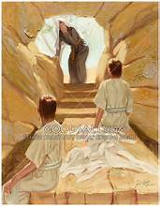
18 Make two cherubim of beaten gold for the two ends of the cover; 19 make one cherub at one end, and the other at the other end, of one piece with the cover, at each end. EX 25: 18-19
JOHN 20:11-13
11 But Mary stayed outside the tomb weeping. And as she wept, she bent over into the tomb 12 and saw two angels in white sitting there, one at the head and one at the feet where the body of Jesus had been. 13 And they said to her, “Woman, why are you weeping?” She said to them, “They have taken my Lord, and I don’t know where they laid him.”
Notes:
We now turn to the stroy of Mary who has returned to the tomb READ WHITE Mary wants to see what the apostles saw and looks into the tomb.
GREEN We again see a reference to the old testament from exodus which points to who Jesus is. When God gave directions for building the arc of the covenant, he said *
READ But mary still believes that Jesus has been stolen. She has such love for Jesus that the appearance of 2 angels do not surprise her.

Slide 9
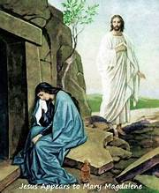
By means of touch and the sharing of a meal, the risen Jesus establishes direct contact with his disciples. He invites them in this way to recognize that he is not a ghost and above all to verify that the risen body in which he appears to them is the same body that had been tortured and crucified, for it still bears the traces of his Passion. Yet at the same time this authentic, real body possesses the new properties of a glorious body: not limited by space and time but able to be present how and when he wills; for Christ's humanity can no longer be confined to earth, and belongs henceforth only to the Father's divine realm. For this reason too the risen Jesus enjoys the sovereign freedom of appearing as he wishes: in the guise of a gardener or in other forms familiar to his disciples, precisely to awaken their faith. CCC645
JOHN 20:14-15
14 When she had said this, she turned around and saw Jesus there, but did not know it was Jesus. 15 Jesus said to her, “Woman, why are you weeping? Whom are you looking for?” She thought it was the gardener and said to him, “Sir, if you carried him away, tell me where you laid him, and I will take him.”
Notes:
READ We can understand that at times when you are not expecting to see someone in a certain place, you have trouble processing who they are. But it appears here and further on in John that Jesus somehow looks different after his resuection. Let’s take a look at the catechism *

Slide 10
JOHN 20: 16-18
and the sheep hear his voice, as he calls his own sheep by name and leads them out. JN 10:3b
27 My sheep hear my voice; I know them, and they follow me. JN 10:27
16 Jesus said to her, “Mary!” She turned and said to him in Hebrew, “Rabbouni,” which means Teacher. 17 Jesus said to her, “Stop holding on to me, for I have not yet ascended to the Father. But go to my brothers and tell them, ‘I am going to my Father and your Father, to my God and your God.’ ”
18 Mary of Magdala went and announced to the disciples, “I have seen the Lord,” and what he told her.
Through his death, Jesus has won their adoption by His own Father. They can now be called brothers or brethren.
Notes:
READ
Mary recognizes Jesus through his voice *
and proclaims his resurrection to the disciples.
We also see Jesus call them his brothers *

Slide 11
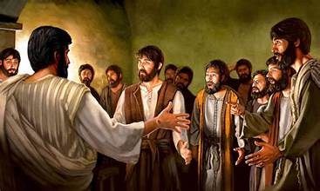
JOHN 20:19-20
Jesus in His glorified body is able to appear in a room with locked doors
Jesus assures them of who he is by visible showing them his wounds
39 Look at my hands and my feet, that it is I myself. Touch me and see, because a ghost does not have flesh and bones as you can see I have.” 40 And as he said this, he showed them his hands and his feet. 41 While they were still incredulous for joy and were amazed, he asked them, “Have you anything here to eat?” 42 They gave him a piece of baked fish; 43 he took it and ate it in front of them.
LK 24:39-43
19 On the evening of that first day of the week, when the doors were locked, where the disciples were, for fear of the Jews, Jesus came and stood in their midst and said to them, “Peace be with you.” 20 When he had said this, he showed them his hands and his side. The disciples rejoiced when they saw the Lord.
Notes:
And now we begin a third story. READ
This is still the same Sunday but in the evening. * * and we know from Luke *
He lets them touch his wounds and eats with them. He assures them he is fully risen and not a spirit.
The other gospels also describe other appearances on this Sunday. In matthew he appeared to the other women
In Mark and Luke he appears to the 2 on the road to Ammeus, And in Luke he appears to Ptere.
The disciples also now believe through personal interaction

Slide 12
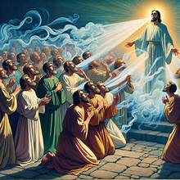
JOHN 20:21-23
7 then the Lord God formed the man[e] out of the dust of the ground and blew into his nostrils the breath of life, and the man became a living being. GN 2:7
21 [Jesus] said to them again, “Peace be with you. As the Father has sent me, so I send you.” 22 And when he had said this, he breathed on them and said to them, “Receive the holy Spirit. 23 Whose sins you forgive are forgiven them, and whose sins you retain are retained.”
Only God forgives sins. Since he is the Son of God, Jesus says of himself, "The Son of man has authority on earth to forgive sins" and exercises this divine power: "Your sins are forgiven." Further, by virtue of his divine authority he gives this power to men to exercise in his name. CCC 1441
Notes:
READ TO RED END
Now Jesus commissions his disciples with continuing his mission.. READ
We are reminded of : * Just as Adam’s life came from God, now the apostles spiritual life comes from Jesus . This is a work of re-creation
From the catechism we read * Jesus not only transfers his own ministry to the apostles, but through the spirit, his own power as well.
So, the apsotles believe jesus is risen through personal interaction and are given a commission by him to forgive sins.

Slide 13
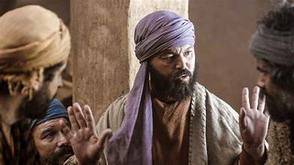
JOHN 20:24-25
I WILlL NOT BELIEVE
I will only believe if I not only see, but pysically touch Jesus’ wounds
24 Thomas, called Didymus, one of the Twelve, was not with them when Jesus came. 25 So the other disciples said to him, “We have seen the Lord.” But he said to them, “Unless I see the mark of the nails in his hands and put my finger into the nail-marks and put my hand into his side, I will not believe.”
Notes:
And now we have the last of our stories. READ GREEN Thomas was not present when Jesus appeared to the other 10,,
READ TO END
Thomas will not accept the testimony of many witnesses and credible witnesses. They are his friends.
So what is he saying * and he makes a specific demand *
Remember, this was the disciple who was prepared to go and die with Jesus. Could it be that he was so shocked awhat happened and so despondent that he was not able to comprehend the possibility that Jesus could be alive? But he is being honest, he is not pretending to go along just to be ageeable.

Slide 14
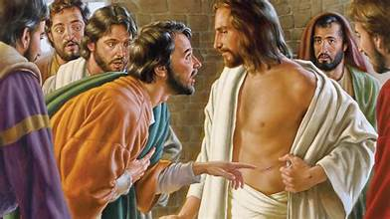
JOHN 20:26-28
It is the next Sunday
Thomas is with the disciples
The doors are again locked
Jesus knows the demand and unbelief of Thomas
“My Lord” – a sign of respsect and trust
“My God” – a confirmation of Jesus divinity
26 Now a week later his disciples were again inside and Thomas was with them. Jesus came, although the doors were locked, and stood in their midst and said, “Peace be with you.” 27 Then he said to Thomas, “Put your finger here and see my hands, and bring your hand and put it into my side, and do not be unbelieving, but believe.” 28 Thomas answered and said to him, “My Lord and my God!”
Notes:
READ WHITE * READ BLUE *
Even though the disciples believe that Jesus has risen, they do not yet understand its meaning or its significance for them. They are still in hiding
READ GREEN *
It must have been a surprise when Jesus repeats his statemenr back to him.
READ After touching Jesus, Thomas utters a statement of Faith in the divinity of Jesus * * Thomas is the first disciple to understand what the resurrection of Jesus trult maens.

Slide 15
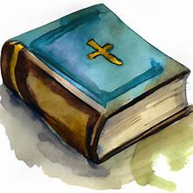
A Beatitude for those who come after
1 Faith is the realization of what is hoped for and evidence of things not seen. HEB 11:1
Revealed truths are normally transmitted by word, by the testimony of other people who, sent by Christ and aided by the Holy Spirit, preach the deposit of faith NAV.
JOHN 20:29
29 Jesus said to him, “Have you come to believe because you have seen me? Blessed are those who have not seen and have believed.”
17 Thus faith comes from what is heard, and what is heard comes through the word of Christ. ROM 10:17
Notes:
READ Thomas needed a personal and physical experience to believe, but here Jusus gives *
as st paul wrote in Hebrews * So we learn * and again from Paul * We have the scritpures to keep us stron in our belief.

Slide 16
JOHN 20:30-31
John’s reason for writing his Gospel
30 Now Jesus did many other signs in the presence of [his] disciples that are not written in this book. 31 But these are written that you may [come to] believe that Jesus is the Messiah, the Son of God, and that through this belief you may have life in his name.
Notes:
Read * We have eye witness testimony not only through Jogn but in all the Gospels to give us a reason to believe and through belief to have etenal life with God.
And this is a wonderful conclusion for this gospel, except for the fact that we have one more chapter.

Slide 17
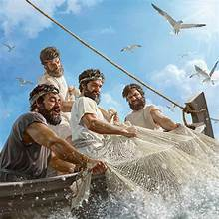
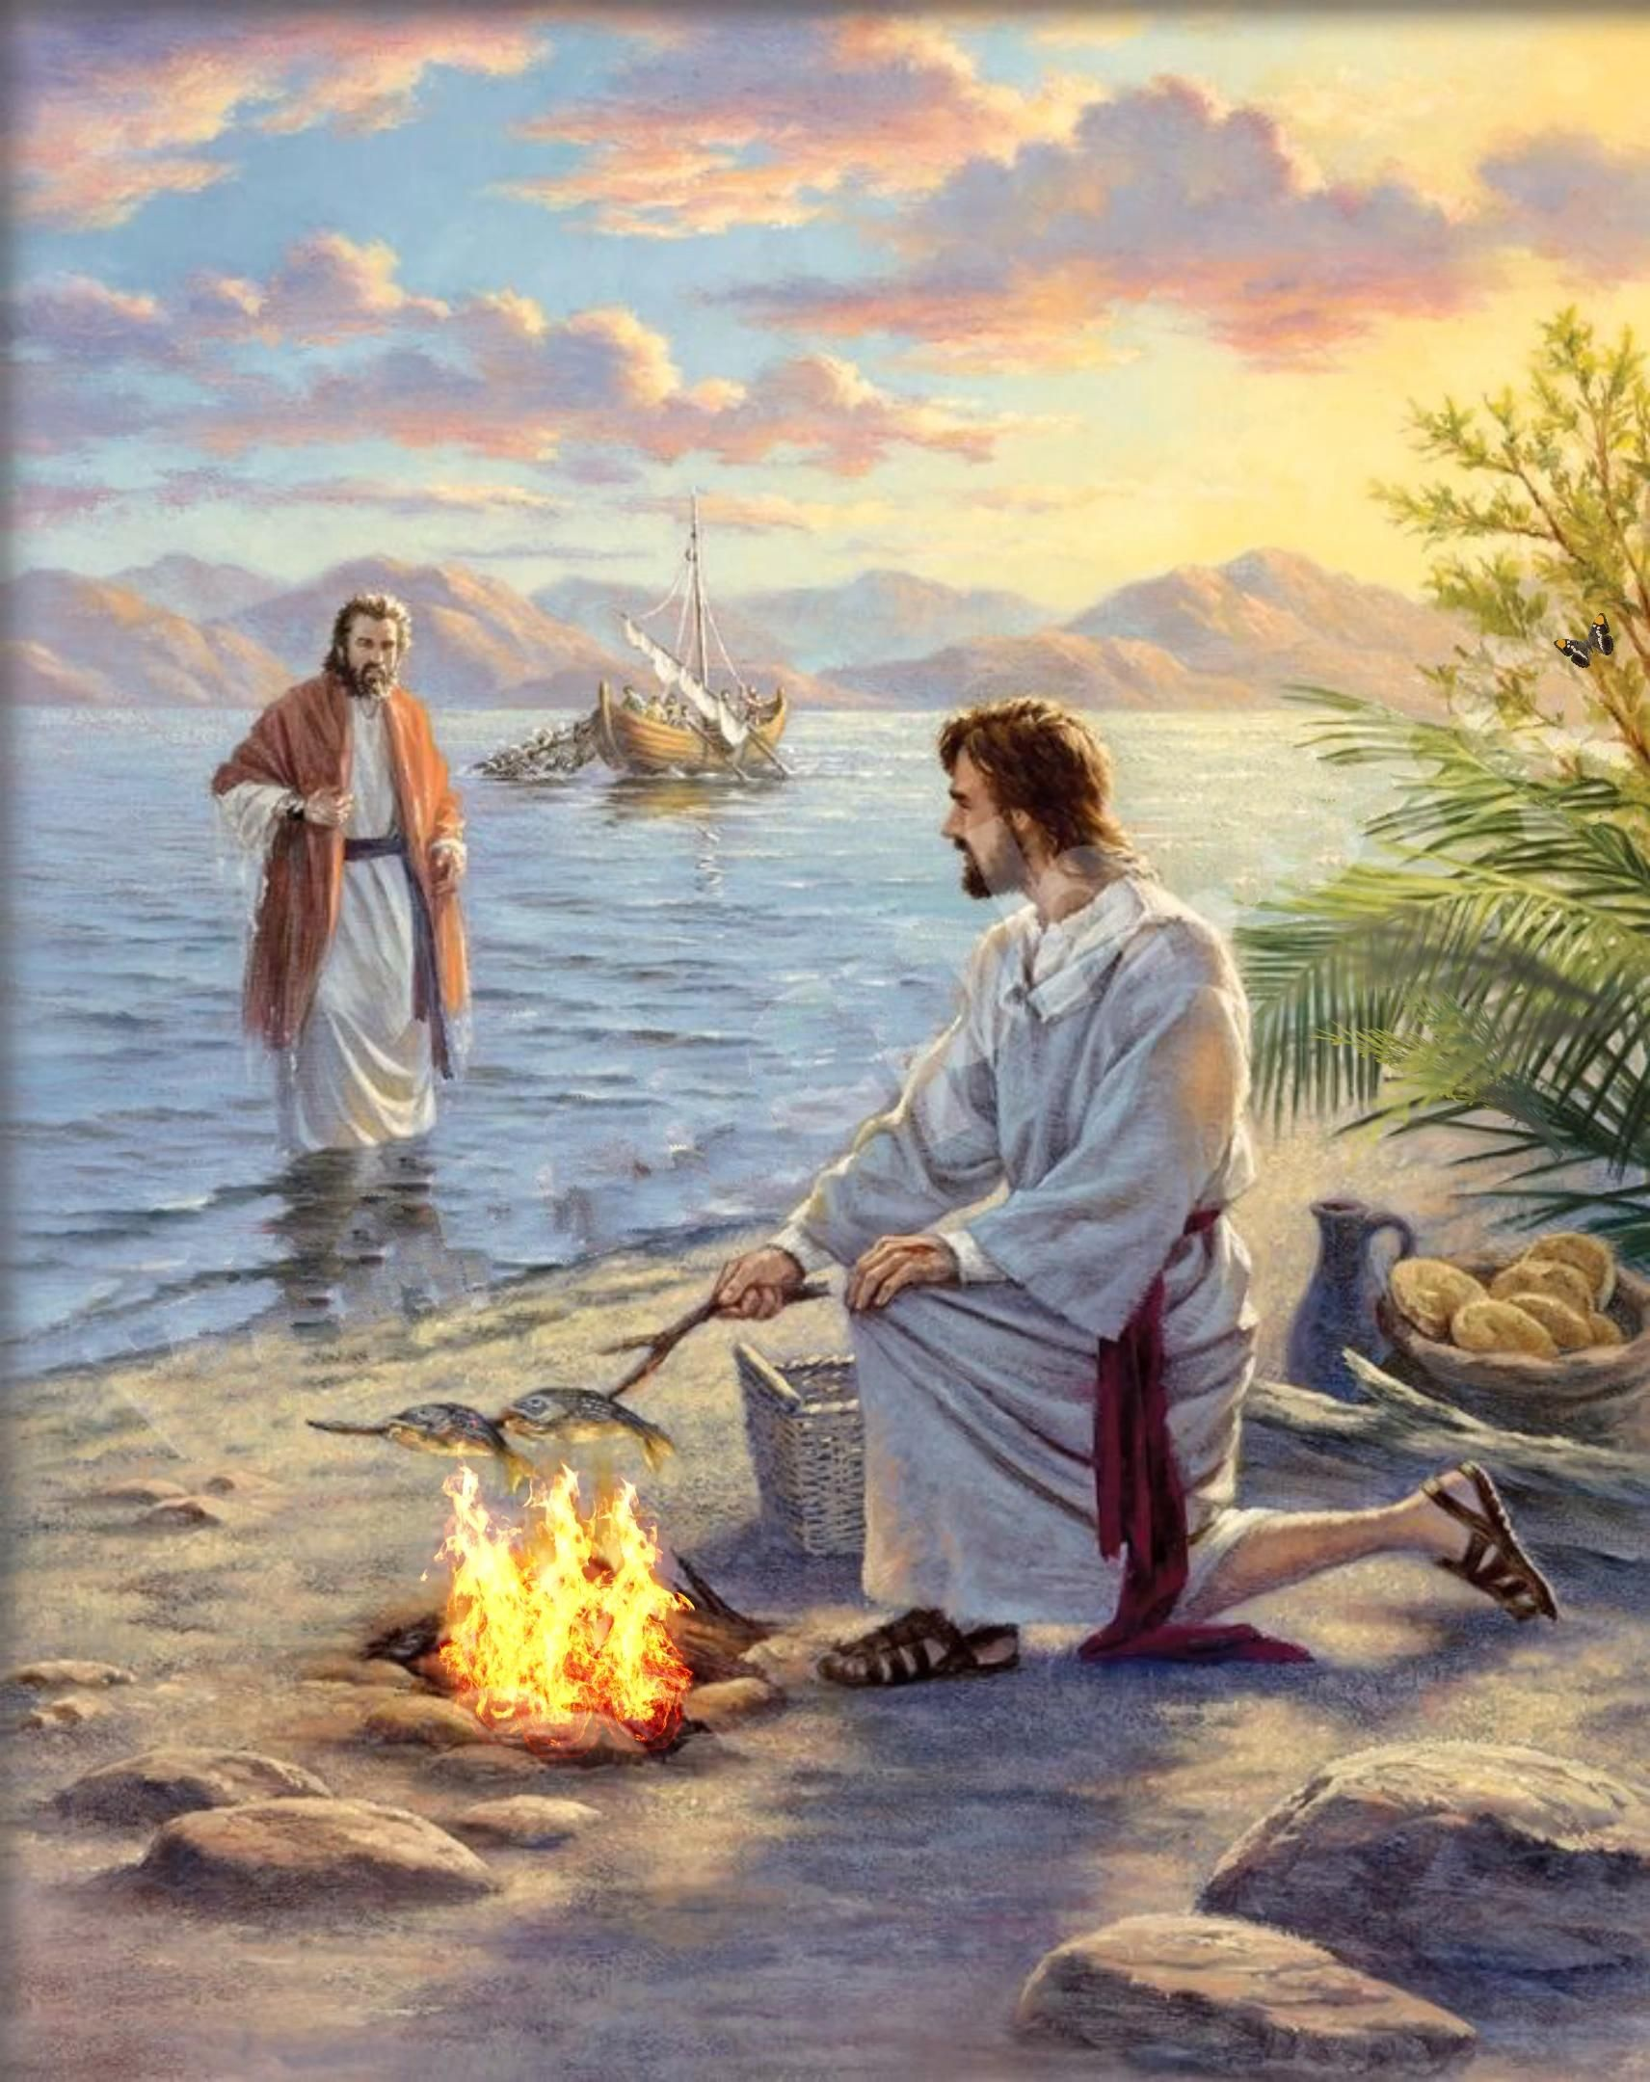
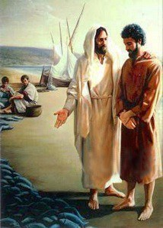
John 21
Addendum
Not sure if added by John or a close follower
Added very soon after the Gospel was written, so is part of every Gospel copy
May have been written to address some issues that were present
Notes:
And so we have a final chapter. What do we know about this chapter? * * * *

Slide 18
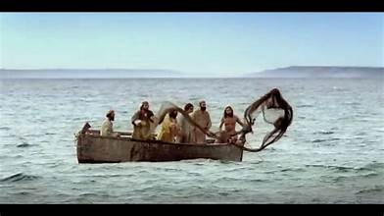
John 21:1-3
7 Disciples
Peter
Thomas
Nathanael
James
John
2 others
1 After this, Jesus revealed himself again to his disciples at the Sea of Tiberias. He revealed himself in this way. 2 Together were Simon Peter, Thomas called Didymus, Nathanael from Cana in Galilee, Zebedee’s sons, and two others of his disciples. 3 Simon Peter said to them, “I am going fishing.” They said to him, “We also will go with you. They went out and got into the boat; but that night they caught nothing.
Notes:
We are going to hear about one more appearance of Jesus READ
The Sea of Tiberius is also known as the Sea of Galilee
We have 7 disciples, 7 being a holy number
* Zebedee’s sons were James and John
We also see that the disciples are not sure what to do next, so have returned to their professions as fisherman and Peter is the decision maker for the group.
They are weary, hungry and hopeless after a night of fishing with no results

Slide 19
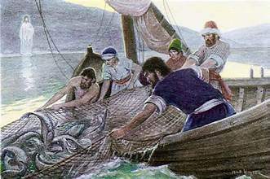
John 21: 4-6
4 When it was already dawn, Jesus was standing on the shore; but the disciples did not realize that it was Jesus. 5 Jesus said to them, “Children, have you caught anything to eat?” They answered him, “No.” 6 So he said to them, “Cast the net over the right side of the boat and you will find something.” So they cast it, and were not able to pull it in because of the number of fish.
They do not recognize him, but Jesus has come to help them at a low point in their lives
Jesus has them use what they have to become successful.
Sometimes it’s worth trying something different
Notes:
READ GREEN *
READ
We have here a lesson for what can be accomplished when you believe. Jesus has come to them at their place of work * * Fishermen fished at night and they could have told Jesus that fishing in the day was pointless and refused. But they gave it a try.

Slide 20
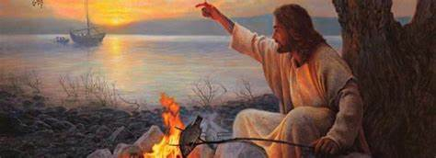
John 21: 7-9
7 So the disciple whom Jesus loved said to Peter, “It is the Lord.” When Simon Peter heard that it was the Lord, he tucked in his garment, for he was lightly clad, and jumped into the sea. 8 The other disciples came in the boat, for they were not far from shore, only about a hundred yards, dragging the net with the fish. 9 When they climbed out on shore, they saw a charcoal fire with fish on it and bread.
We see the impetuous Peter again
18 Now the slaves and the guards were standing around a charcoal fire that they had made, because it was cold, and were warming themselves. Peter was also standing there keeping warm.
JN 18:18
Notes:
READ WHITE *
READ GREEN there is only one other time a charcoal fire has been mentioned in John *

Slide 21
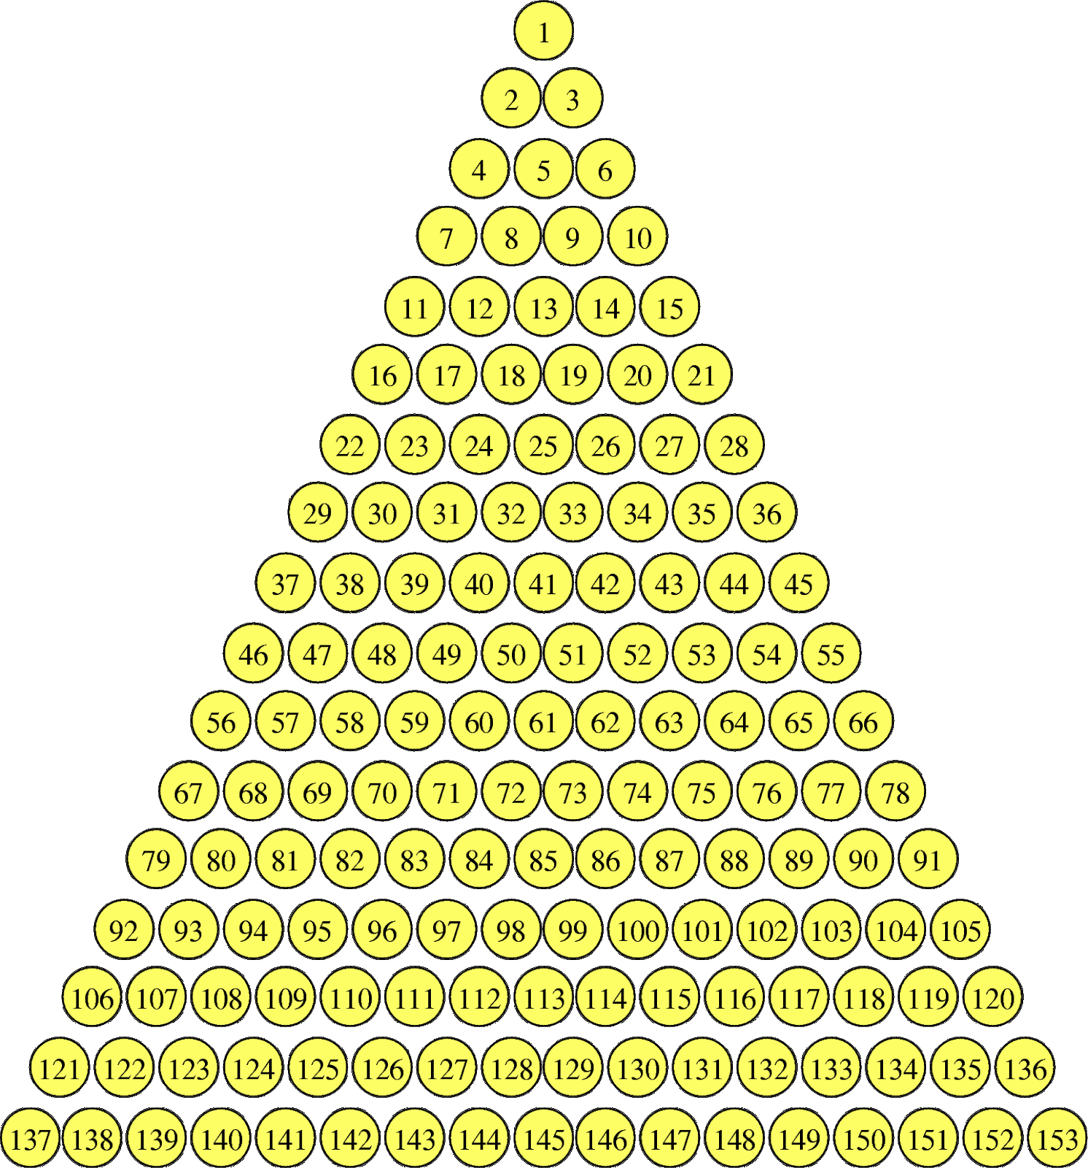
John 21: 10-14
NUMEROLOGY
St Jerome claimed that there were 153 different types of fish in the world
Cyril of Alexandria thought that 100 stood for Gentiles , 50 stood for Israel and 3 was the Trinity
St Augustine thought that since 153 is the sum of all numbers from 1 to 17, the fish catch points to 17, which would be the 10 Commandments and the 7 gifts of the Holy Spirit
10 Jesus said to them, “Bring some of the fish you just caught.” 11 So Simon Peter went over and dragged the net ashore full of one hundred fifty-three large fish. Even though there were so many, the net was not torn. 12 Jesus said to them, “Come, have breakfast.” And none of the disciples dared to ask him, “Who are you?” because they realized it was the Lord. 13 Jesus came over and took the bread and gave it to them, and in like manner the fish. 14 This was now the third time Jesus was revealed to his disciples after being raised from the dead.
Notes:
READ ALL we kniw numerology * was an important element in John’s writing. We know that 3 is a holy number and this is the third time Jesus has appeared to his disciple. We know that he has appeared to others, but as far as the group, this is the 3rd appearance.
And 153 fish is an intesting number. There are many theories as to what this means, and ther is no agreement.The original meanin has been lost. But, I am going to present 3 of the theories here.
*** and for those who are not mathematically inclined, St ugustine was referring to this type of pyramid with 17 rows. *

Slide 22
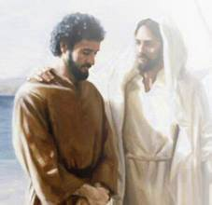
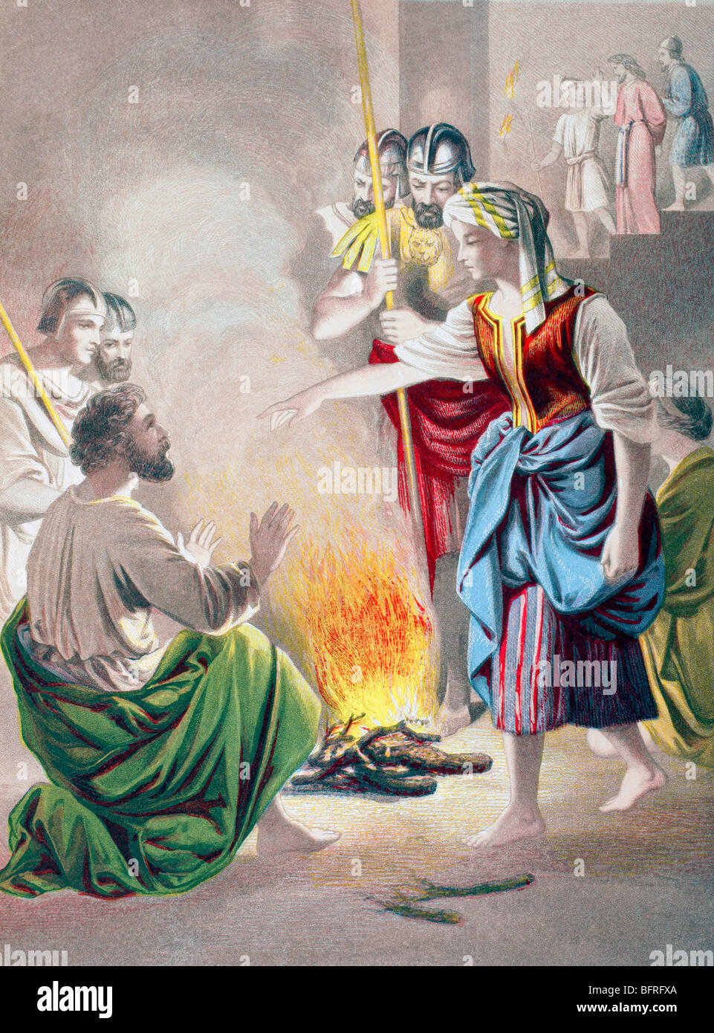
John 21:15-16
17 Then the maid who was the gatekeeper said to Peter, “You are not one of this man’s disciples, are you?” He said, “I am not.”
JN 18:17
When they had finished breakfast, Jesus said to Simon Peter, “Simon, son of John, do you love me more than these?” He said to him, “Yes, Lord, you know that I love you.” He said to him, “Feed my lambs.”
16 He then said to him a second time, “Simon, son of John, do you love me?” He said to him, “Yes, Lord, you know that I love you.” He said to him, “Tend my sheep.”
25 Now Simon Peter was standing there keeping warm. And they said to him, “You are not one of his disciples, are you?” He denied it and said, “I am not.” JN 18:25
Notes:
Jesus speaks directly to Peter. He will question Pter 3 times . 3 times Pter will reaffirm his love for Jesus. He is given the chance to atone for his triple denial of Jesus in front of that other charcoal fire.
Read * READ *

Slide 23
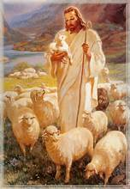
John 21:17-19
26 One of the slaves of the high priest, a relative of the one whose ear Peter had cut off, said, “Didn’t I see you in the garden with him?” 27 Again Peter denied it. And immediately the cock crowed. JN 18:26-27
17 He said to him the third time, “Simon, son of John, do you love me?” Peter was distressed that he had said to him a third time, “Do you love me?” and he said to him, “Lord, you know everything; you know that I love you.” [Jesus] said to him, “Feed my sheep.
Peter puts everything in Jesus hands knowing that Jesus knows him better than he himself
Notes:
READ *
And we see here * Pter’s restitution is complete
and * Jesus the good shepherd entrusts to Pter the task of shepherding his entire flock. It is to Peter alone that Jesus after his resurrection bestowed the jurisdiction of chief pastor & ruler over all his fold.

Slide 24
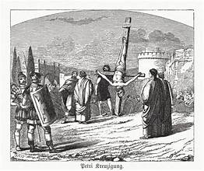
John 21:17-19
18 Amen, amen, I say to you, when you were younger, you used to dress yourself and go where you wanted; but when you grow old, you will stretch out your hands, and someone else will dress you and lead you where you do not want to go.” 19 He said this signifying by what kind of death he would glorify God. And when he had said this, he said to him, “Follow me.”
A prophecy of the kind of death Peter will have
Keep on following me.
Peter had followed Christ, but not continuously in the past. For the future he was to follow steadfastly in the ways of the Lord including unto death on a cross
Notes:
READ *
and “follow me” actually translates to * *
So we see here that this addendum further clarifies the primacy of Peter.

Slide 25
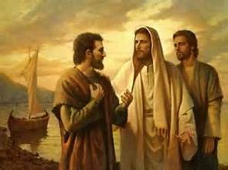
John 21:20-22
Peter represents most all of us. We find it easy to deflect any personal challenge from Jesus by wondering and even worrying about what other disciples are doing or what Jesus may require from them.
20 Peter turned and saw the disciple following whom Jesus loved, the one who had also reclined upon his chest during the supper and had said, “Master, who is the one who will betray you?” 21 When Peter saw him, he said to Jesus, “Lord, what about him?” 22 Jesus said to him, “What if I want him to remain until I come? What concern is it of yours? You follow me.”
Notes:
READ BLUE Peter’s first response to the personal challenge from Jesus is to deflect by wondering what Jesus wanted to do regarding someone else. Peter is human with human foibles
*
READ GREEN God has a destiny for each one of us. Pter and we need to consider what Jesus requires of us knowing that he might require something different from another.

Slide 26
John 21:23
This verse is included to correct a misunderstanding among believers that the Apostle John would remain alive until Christ returns in glory. (Ignatius Study Bible)
23 So the word spread among the brothers that that disciple would not die. But Jesus had not told him that he would not die, just “What if I want him to remain until I come? [What concern is it of yours?]”
Notes:
READ *

Slide 27
John 21:24-25
20 Peter turned and saw the disciple following whom Jesus loved, the one who had also reclined upon his chest during the supper and had said, “Master, who is the one who will betray you?” JN 21:20
24 It is this disciple who testifies to these things and has written them, and we know that his testimony is true. 25 There are also many other things that Jesus did, but if these were to be described individually, I do not think the whole world would contain the books that would be written.
2 Together were Simon Peter, Thomas called Didymus, Nathanael from Cana in Galilee, Zebedee’s sons, and two others of his disciples. JN 21:2
The Gospels were written by men who were among the first to have the faith and wanted to share it with others. Having known in faith who Jesus is, they could see and make others see the traces of his mystery in all his earthly life. CCC 515a
Notes:
READ WHITE we are given a very strong hint as to who the gospel writer is.
We know from vs 20 * and from Vs 2. * John was one of the sons of Zebedee and he was know as the beloved disciple.
And the gospel ends with a reminder
READ *

Slide 28
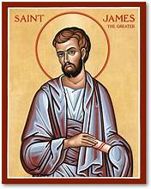
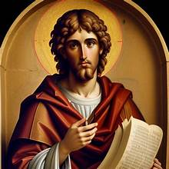
Where have we gone
JOHN
Time of persecution
MESSAGE:
31 But these are written that you may [come to] believe that Jesus is the Messiah, the Son of God, and that through this belief you may have life in his name.
JN 20:31
James
Time of persecution
Message:
Encourages believers to embrace trials with joy, knowing that steadfastness in the face of difficulty
leads to growth and a complete faith.
Warns of the destructive nature of temptation
Notes:
So let’s take a brief look at where we have gone.
We started out with *James * *
We end up with *John * *

Slide 29
PRAYER Gracious and loving Father,We thank You for walking with us through the Gospel of John . We praise You for the witness of Your Son—the Word made flesh—and for the "I Am" promises that reveal His divine nature. Thank You for every insight and every moment Your Spirit has been our Teacher during this season of study. As we close this chapter, we ask that Your Word would not remain only in our minds, but be planted deeply in our hearts. When doubts arise, anchor us in Your truth; when we are weary, remind us that You are our source of Living Water. Help us to trust in the One who is the Way, the Truth, and the Life. Deepen our faith and help us to abide in Christ each day. Shape us into people who reflect His light in a world that longs for hope, bearing fruit that brings You glory. May our belief grow stronger and our love become more like His. In the name of Jesus Christ our Lord, Amen.

