Slide 1
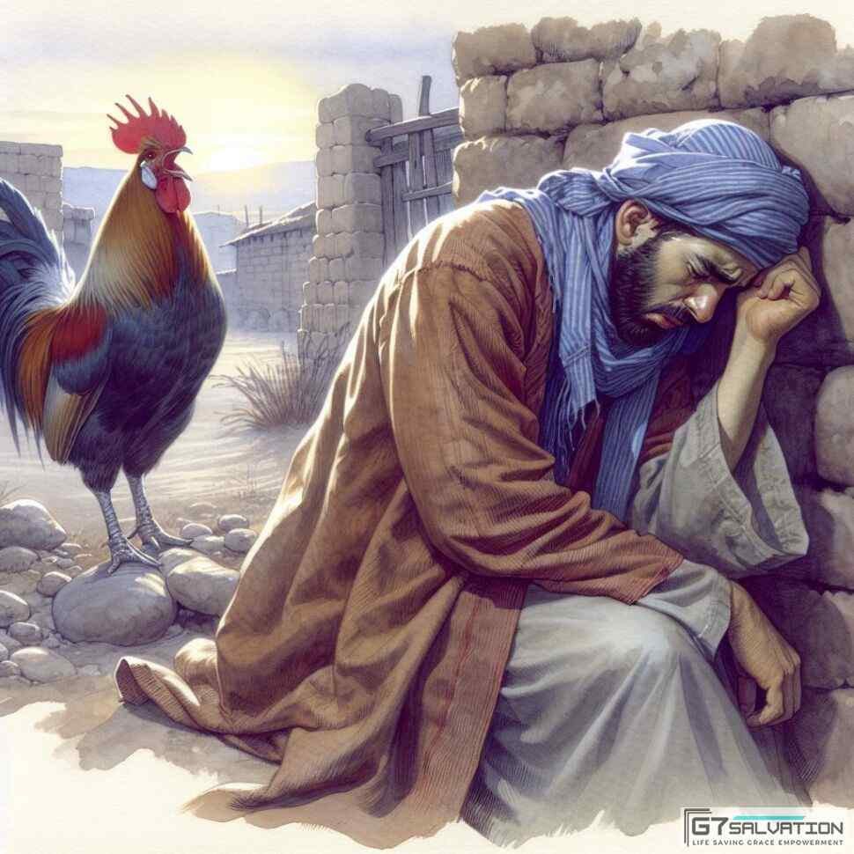
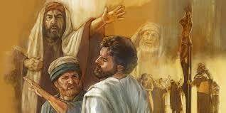
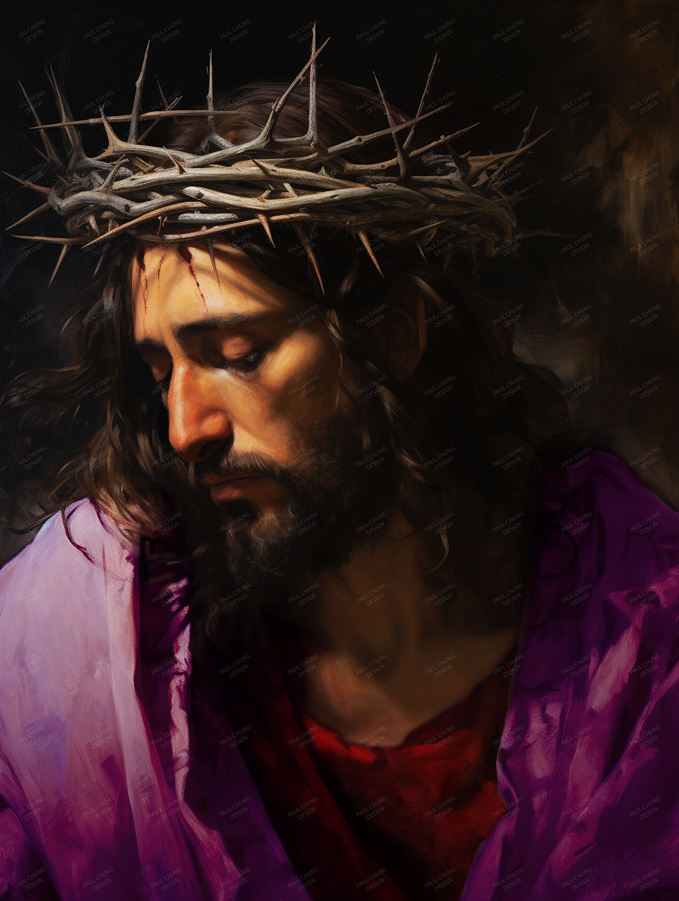
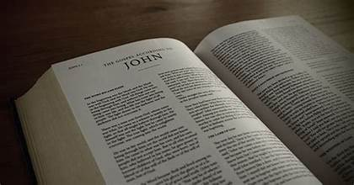

John 18:15- 19:15
Peter Denies Jesus Three Times
Jesus on Trial Before Annas/Caiaphas/ Pilate

Slide 2

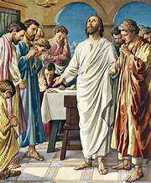
In our last lessons..
Chapters 13- 16 included a farewell address to Jesus’ disciples in the upper room.
Chapter 17 – 18:14 in John’s Gospel is a prayer often referred to as Jesus’ High Priestly Prayer.
Jesus prays for a return of the glory He had before taking the form of a human being. He prays that He will glorify the Father by completing His work.
Jesus then prays for the disciples. He prays for unity among them and protection from “the evil one.”
Finally, He prays for all of those who believe because of the testimony of His disciples. There is another prayer for unity for these future Christians.

Slide 3
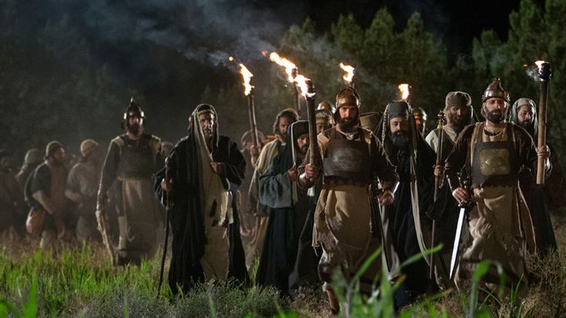
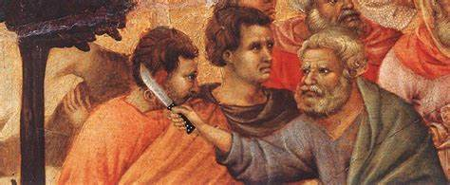
John 18:1-14
Chapter 18 begins with Jesus and his disciples leaving the upper room for Gethsemane.
Judas arrives with Roman troops and Temple Guards wielding clubs and swords and carrying torches. Trying to calm what could be a blood bath, Jesus admits to being the one they are looking for.
The divine power of His statement “I AM” knocks the soldiers to the ground.
In anger, Peter cuts off the ear of the slave of the high priest.
The lesson ended with Jesus being taken to Annas.

Slide 4
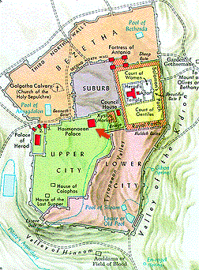
The Temple
The Garden of Gethsemane
Hasmonean Palace (Annas)
The Praetorium
(Pilate)
Golgotha

Slide 5

John 18:15-24
Who is this unnamed disciple?
Many believe it is John, the beloved disciple and evangelist.
Problem: How does a Galilean fisherman become acquainted with the high priest?
¹⁵ Simon Peter and another disciple followed Jesus.
Now the other disciple was known to the high priest, and he entered the courtyard of the high priest with Jesus. ¹⁶ But Peter stood at the gate outside. So, the other disciple, the acquaintance of the high priest, went out and spoke to the gatekeeper and brought Peter in.
1
2
3
Notes:
1.The name Simon Peter is used here, but during the narrative of his denials he is only called Peter. The full name, Simon Peter is used again in 18:25 after Jesus’ inquiry by Annas.
2. Peter, John and James were part of Jesus’ inner circle, invited to be present at the Transfiguration. John and Peter are later paired as eyewitnesses at the tomb (20:2–8)
John alone supplies the intimate court-scene details (18:19–24) missing from the Synoptics, implying first-hand presence.
3. Because of this some scholars believe it is more likely that a Judean, someone from Jerusalem is the disciple. Perhaps not one known as a disciple such as Nicodemus or Joseph of Arimathea.

Slide 6
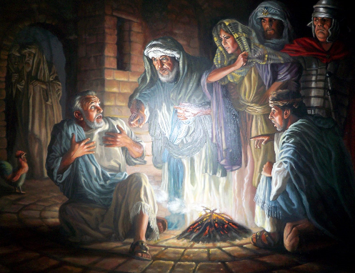
John 18:17-18
¹⁷ Then the maid who was the gatekeeper said to Peter, “You are not one of this man’s disciples, are you?”
He said, “I am not.”
¹⁸ Now the slaves and the guards were standing around a charcoal fire that they had made, because it was cold, and were warming themselves. Peter was also standing there keeping warm.
In all four Gospels, Peter’s first denial is to a maid or servant- girl. Only John mentions her occupation.

Slide 7
John 18:19-21
Mark 14:17-50
Jesus said to them in reply, “Have you come out as against a robber, with swords and clubs, to seize me? ⁴⁹ Day after day I was with you teaching in the temple area, yet you did not arrest me; but that the scriptures may be fulfilled.” ⁵⁰ And they all left him and fled.
¹⁹ The high priest questioned Jesus about his disciples and about his doctrine.
²⁰ Jesus answered him, “I have spoken publicly to the world. I have always taught in a synagogue or in the temple area where all the Jews gather, and in secret I have said nothing.
²¹ Why ask me? Ask those who heard what I said to them. They know what I said.”
1
2
3
Notes:
It does not appear that Caiaphas is present.
In the Gospel of Mark, Jesus says something similar when they come to arrest him.
In Jewish Law it is improper for an accused person to convict himself! Jesus is demanding a trial with witnesses. Two witnesses are required in a trial.
This is a good indication that this trial before Annas is not a formal trial.

Slide 8
John 18:22-24 Mark 14:55-62
⁵⁵ The chief priests and the entire Sanhedrin kept trying to obtain testimony against Jesus in order to put him to death, but they found none. ⁵⁶ Many gave false witness against him, but their testimony did not agree. ⁵⁷ Some took the stand and testified falsely against him, alleging, ⁵⁸ “We heard him say, ‘I will destroy this temple made with hands and within three days I will build another not made with hands.’” ⁵⁹ Even so their testimony did not agree. ⁶⁰ The high priest rose before the assembly and questioned Jesus, saying, “Have you no answer? What are these men testifying against you?” ⁶¹ But he was silent and answered nothing. Again the high priest asked him and said to him, “Are you the Messiah, the son of the Blessed One?” ⁶² Then Jesus answered, “I am;
²² When he had said this, one of the temple guards standing there struck Jesus and said, “Is this the way you answer the high priest?”
²³ Jesus answered him, “If I have spoken wrongly, testify to the wrong; but if I have spoken rightly, why do you strike me?”
²⁴ Then Annas sent him bound to Caiaphas the high priest.
1
2
Notes:
John may not have been an eyewitness to what happened before Caiaphas. Not a word of that trial is written in John’s Gospel. So Here is what the Gospel of Mark says.
In the Gospel of Luke, Those who hold Him, Mock and beat him, blindfolding Him and then challenge Him to Prophesy.

Slide 9
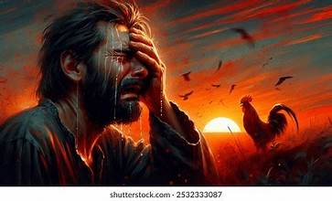
John 18:25 -27
John is telling us what was going on outside while Jesus was being interrogated.
²⁵ Now Simon Peter was standing there keeping warm. And they said to him, “You are not one of his disciples, are you?” He denied it and said, “I am not.”
²⁶ One of the slaves of the high priest, a relative of the one whose ear Peter had cut off, said,
“Didn’t I see you in the garden with him?”
²⁷ Again Peter denied it. And immediately the cock crowed.
1
2
3
Notes:
The They here is likely the slaves and the guards mentioned earlier.
Our author, John shows detailed knowledge of of the high priests household.
Time to pause for reflection here. What do you suppose would have happened if Peter admitted being Jesus’ disciple?
Would he have been arrested too? Or would he have been called to testify against Jesus?

Slide 10

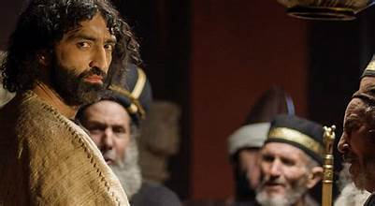
Luke 22:60-61
⁶⁰ But Peter said, “My friend, I do not know what you are talking about.” Just as he was saying this, the cock crowed, ⁶¹ and the Lord turned and looked at Peter; and Peter remembered the word of the Lord, how he had said to him, “Before the cock crows today, you will deny me three times.”
⁶² He went out and began to weep bitterly.
Notes:
I wanted to share Luke’s version of Peter’s third denial here.

Slide 11
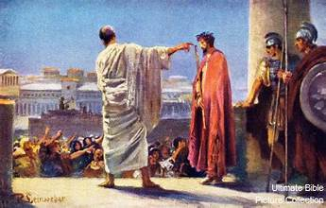
John 18:28-32
The Anchor Bible: the interrogation by Annas and Peter’s denials came to an end around 3 AM.
The next 3 hours were spent with Caiaphas and finally around 6AM He was led to Pilate.
So, who is it that is escorting Jesus from Caiaphas to Pilate?
In Luke 22, the whole Sanhedrin rose and led Jesus to Pilate.
Then they brought Jesus from Caiaphas to the praetorium. It was morning. And they themselves did not enter the praetorium, in order not to be defiled so that they could eat the Passover.
²⁹ So Pilate came out to them and said, “What charge do you bring [against] this man?” ³⁰ They answered and said to him, “If he were not a criminal, we would not have handed him over to you.” ³¹ At this, Pilate said to them, “Take him yourselves, and judge him according to your law.”
1
Notes:
1. So after the interrogation by Annas and hours before Caiaphas, they still do not present a real charge to Pilate.

Slide 12
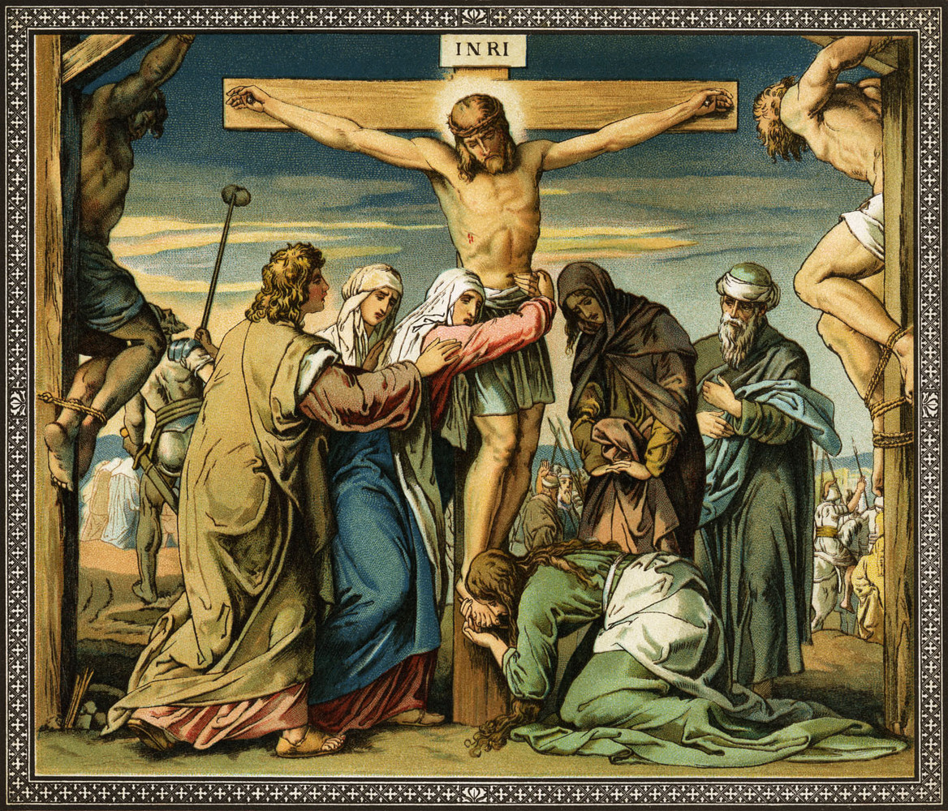
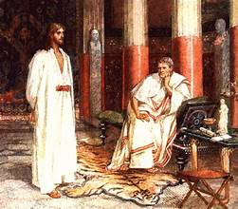
John 18:31-35
John 12:32 And when I am lifted up from the earth, I will draw everyone to myself.
The Jews answered him, “We do not have the right to execute anyone,”
³² in order that the word of Jesus might be fulfilled that he said indicating the kind of death he would die.
³³ So Pilate went back into the praetorium and summoned Jesus and said to him,
“Are you the King of the Jews?”
³⁴ Jesus answered, “Do you say this on your own or have others told you about me?”
³⁵ Pilate answered, “I am not a Jew, am I? Your own nation and the chief priests handed you over to me.
What have you done?”
2
3
Notes:
Pilate wishes to have a private discussion with Jesus. The Jews would not follow them inside!
Jesus seems to be asking Pilate, DID YOU FIGURE THIS OUT ON YOUR OWN, OR DID SOMEONE TELL YOU THIS?
3. John presents a picture of Pilate that is sympathetic and reluctant to execute Jesus.

Slide 13
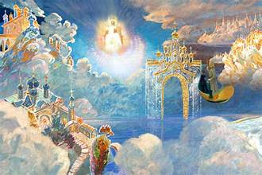
John 18:36-38
³⁶ Jesus answered, “My kingdom does not belong to this world. If my kingdom did belong to this world, my attendants [would] be fighting to keep me from being handed over to the Jews. But as it is, my kingdom is not here.”
³⁷ So Pilate said to him,
“Then you are a king?”
Jesus answered, “You say I am a king. For this I was born and for this I came into the world, to testify to the truth. Everyone who belongs to the truth listens to my voice.”
³⁸ Pilate said to him, “What is truth?”
“It is not worldly or on earth, but heavenly and angelic, and it would be established at the end of the world.”
(Grandson of Jude to Emperor Domitian recorded by Eusebius)
2
I AM the Way, the Truth and the Life. John 14:6
3
Notes:
1. Jesus did not answer Pilate’s question What have your done? Instead, He does answer the question about being king.
The Kingdom of heaven is not a political kingdom.
2. This quote comes from Eusebius’ History written in the mid third century.
The Granson of St. Jude reportedly said this in response to Emperor Domition, at the end of the first century AD.
3. If it is not of this world or political, Pilate is not interested. The Truth is standing right in front of Him but he cannot see it or hear it. Pilate does not belong to the Truth.
Reminds me of Jack Nicholson in A Few Good Men- Only Jesus is the Truth.

Slide 14
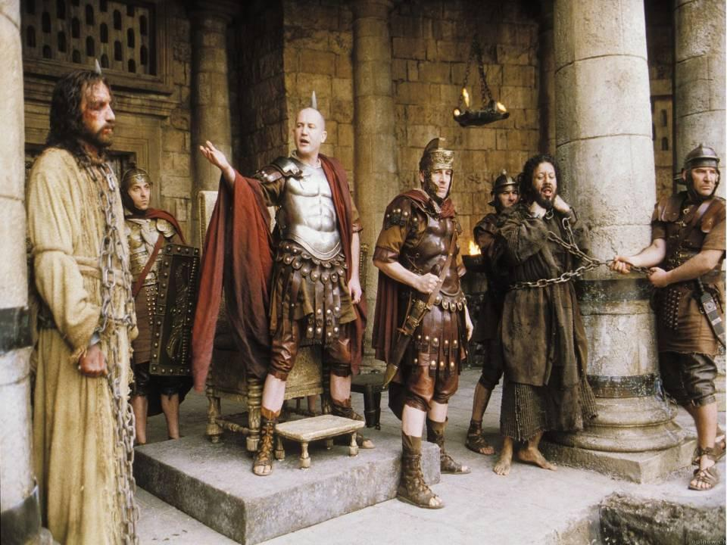
John 18:38-40
The Aramaic name, Barabbas, means “son of the father”
Matt 27:16-17 - “a notorious prisoner named Jesus Barabas..” “Which one do you want me to release to you, [Jesus] Barabbas, or Jesus called Messiah?”
Mark 15:7 A man called Barabbas was then in prison along with the rebels who had committed murder in a rebellion.
Luke 23:19 (Now Barabbas had been imprisoned for a rebellion that had taken place in the city and for murder.)
When he had said this, he again went out to the Jews and said to them,
“I find no guilt in him. ³⁹ But you have a custom that I release one prisoner to you at Passover. Do you want me to release to you the King of the Jews?”
⁴⁰ They cried out again, “Not this one but Barabbas!”
Now Barabbas was a revolutionary.
1
2
Notes:
This Not Guilty verdict will be given two more times in this Gospel. A similar judgment is repeated three times in Luke as well.
In both Gospels, the first “not Guilty” judgment came right after the question of Jesus’ kingship.
2. Many commentaries report that such a practice of releasing a prisoner can not be verified. It may have been for a tradition and not a law. However there is a comment in the Mishnah, the Jewish commentary on oral tradition and Torah that speaks of the need for slaughtering a paschal lamb for one whom “they promised to release from prison” on Passover Eve. It is argued that the Romans may have taken over the tradition from the earlier Hasmoneans. In any case, all four Gospels mention the release of Barabas.

Slide 15
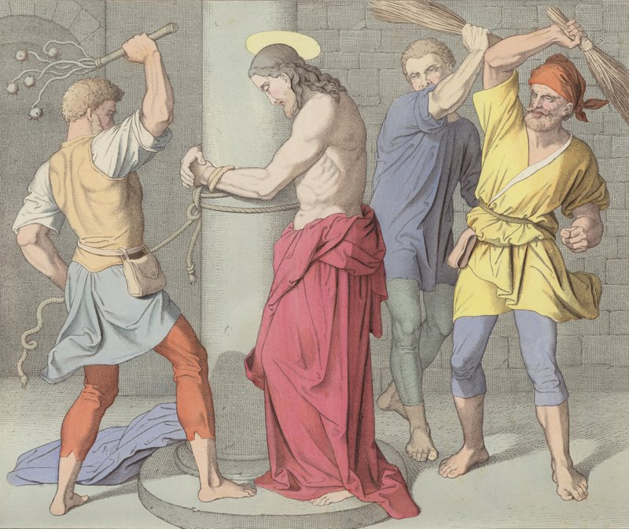
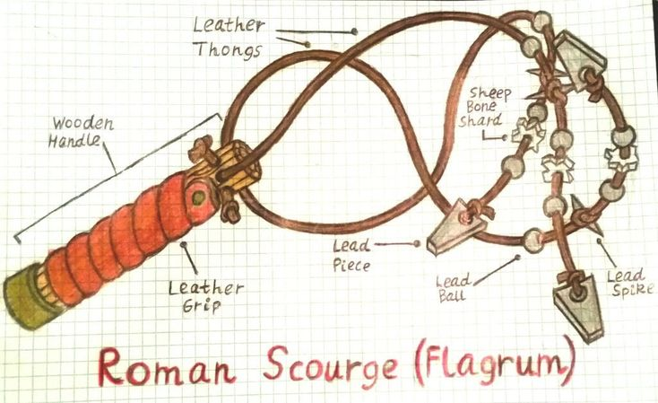
John 19:1-5
Flogging or scourging was a part of every Roman death sentence.
A short whip with several single or braided leather thongs of variable lengths was used, in which small iron balls or sharp pieces of sheep bones were tied at intervals.
For scourging, the man was stripped of his clothing, and his hands were tied to an upright post.
The back, buttocks, and legs were flogged either by two soldiers or by one who alternated positions.
Scourging was intended to weaken the victim to a state just short of collapse or death. The extent of blood loss may well have determined how long the victim would survive.
1
¹ Then Pilate took Jesus and had him scourged. ² And the soldiers wove a crown out of thorns and placed it on his head, and clothed him in a purple cloak, ³ and they came to him and said, “Hail, King of the Jews!” And they struck him repeatedly.
2
Notes:
Only women, senators or soldiers were exempt from this torture, unless they were deserters.
The mocking was to humiliate the victim. Purple is the color reserved for royalty. The crown may very well have had the appearance of a real crown.

Slide 16
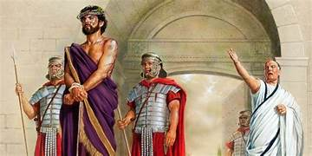
John 19:4-5
Everything about this experience was designed to humiliate Jesus.
In Matthew 26:67-68 the Jewish rulers mocked Jesus as Messiah. Here the Romans mock Him as King.
⁴ Once more Pilate went out and said to them, “Look, I am bringing him out to you, so that you may know that I find no guilt in him.” ⁵ So Jesus came out, wearing the crown of thorns and the purple cloak. And he said to them, “Behold, the man!”
Notes:
This is the second time that Pilate says he finds no guilt in Jesus.

Slide 17
John 19:6-9
This is the first time in the Gospel of John that the Jewish leaders reveal the actual charge against Jesus.
⁶ When the chief priests and the guards saw him, they cried out, “Crucify him, crucify him!”
Pilate said to them, “Take him yourselves and crucify him. I find no guilt in him.”
⁷ The Jews answered, “We have a law, and according to that law he ought to die, because he made himself the Son of God.”
⁸ Now when Pilate heard this statement, he became even more afraid, ⁹ and went back into the praetorium and said to Jesus,
“Where are you from?” Jesus did not answer him.
Though harshly treated, he submitted and did not open his mouth; Like a lamb led to slaughter or a sheep silent before shearers, he did not open his mouth.
(Isaiah 53:7)
1
2
3
Notes:
1.This is the third time that Pilate says he sees no guilt in Jesus.
2.t could be that Pilate is a bit superstitious. Or that In Roman mythology a God’s son, such as Hercules, would have magical powers, strength or wisdom.
Demigods, were the offspring of a god and a mortal. For Romans a “Son of God” could be a divine or semi-divine being.
3.This questions could be looking for confirmation of whether Jesus is from Heaven and is indeed God’s son or is He human?
Or this could be a way of finding a legal loophole to avoid this crucifixion.
Jesus’ silence is mentioned in Matthew and in Mark as well.

Slide 18

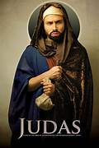
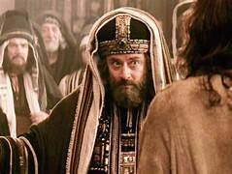
John 19:10-11
¹⁰ So Pilate said to him, “Do you not speak to me?
Do you not know that I have power to release you and I have power to crucify you?”
¹¹ Jesus answered [him], “You would have no power over me if it had not been given to you from above.
For this reason, the one who handed me over to you has the greater sin.”
1
2
3
Notes:
Pilate is reminding Jesus that he has the power of life or death over Jesus. It would be wise for Jesus to answer him.
Pilate’s power is limited, Jesus claims. Pilate can only do what is permitted by God.
The one who Betrayed me, could be meant here and this would refer to Judas Iscariot. However, Caiaphas and the Jewish authorities could also be implicated here.
Pilate has been given a role in the passion by God’s will and is acting against Jesus, willingly or unwillingly. But the one who handed Him over was acting deliberately.

Slide 19
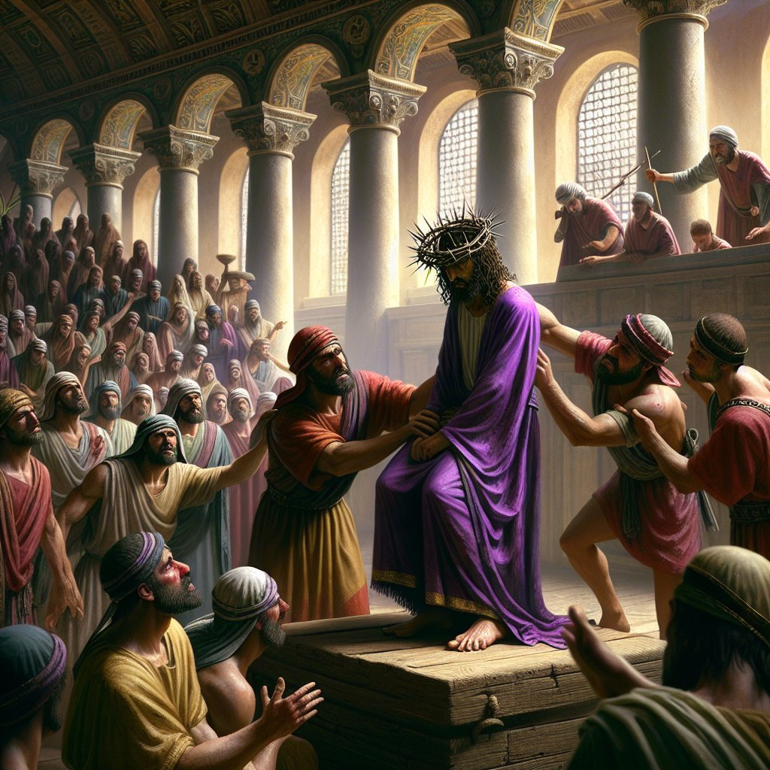
John 19:12-14
“Friend of Caesar” is a title or honor granted to Pilate. This puts Pilate in a group that was honored by the emperor for their loyalty. It also entrusted him with greater authority.
This sounds like a veiled threat of blackmail.
If Jesus calls himself a king, he is an enemy of the state.
According to John, this is both the day before the Sabbath and the day before Passover.
¹² Consequently, Pilate tried to release him; but the Jews cried out, “If you release him, you are not a Friend of Caesar. Everyone who makes himself a king opposes Caesar.”
¹³ When Pilate heard these words, he brought Jesus out and seated him on the judge’s bench in the place called Stone Pavement, in Hebrew, Gabbatha.
¹⁴ It was preparation day for Passover, and it was about noon. And he said to the Jews,
“Behold, your king!”
1
Notes:
1. Earlier Pilate presented Jesus to the crowd after being scourged and said, Behold the Man. Here, calling him King, makes Jesus guilty of treason, a crime against the Roman Empire.

Slide 20
John 19:15-16
Pilate prefers to be a friend of an earthly king (Caesar). He chooses human power and glory.
These are shocking words. Do the Jewish leaders really prefer to honor a pagan king rather than the king sent by God?
Is this a rejection of the Kingdom of God?
¹⁵ They cried out,
“Take him away, take him away! Crucify him!”
Pilate said to them,
“Shall I crucify your king?”
The chief priests answered,
“We have no king but Caesar.”
¹⁶ Then he handed him over to them to be crucified.

Slide 21
The Temple
The Garden of Gethsemane
Hasmonean Palace (Annas)
The Praetorium
(Pilate)
Golgotha

Slide 22

Let us Pray
Jesus, your journey to the cross was full of betrayal, grief, torture, and darkness, yet your love for us, your people, propelled you onward.
Help us to comprehend just how powerful that love is, that you would suffer such a cruel death to make way for us to be with you in glory forever.
May our praise never cease in this season. May our worship be unending. May our love for you find new depths. May this season bring new hope and new healing.
May we journey toward the cross prayerfully and purposefully, even through the pain, doubt, questions, and searching.
May Easter be a day of complete celebration as we rejoice in our risen Savior and praise our gracious Father.
In you, we find the truest joy, Jesus. Amen.

