Slide 1
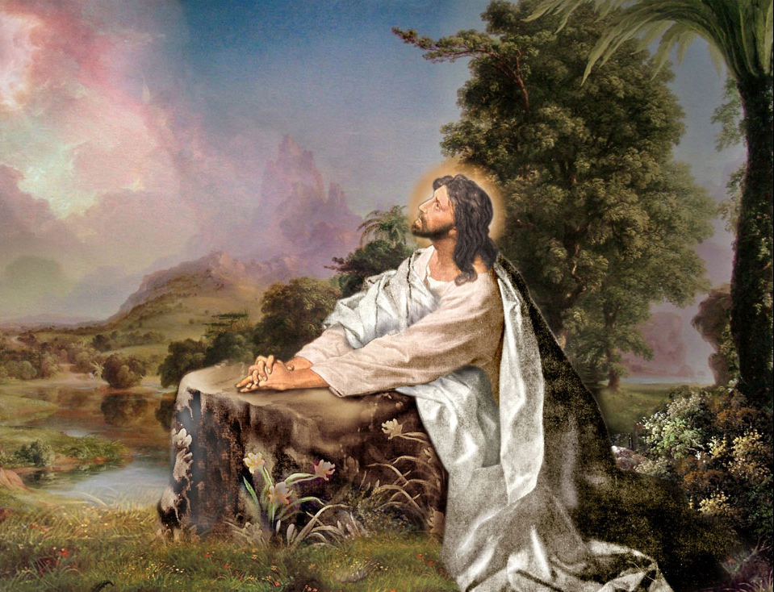

John 17:1-26
John 17 – 18:14
Jesus High Priestly Prayer and Arrest

Slide 2
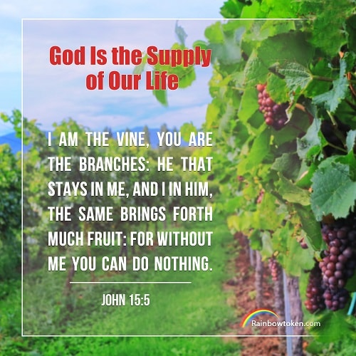
Flashback: John 15:1-5 I am the true vine, and my Father is the vine grower.
1 "I am the true vine, and my Father is the vine grower.
2 He takes away every branch in me that does not bear fruit, and everyone that does he prunes so that it bears more fruit.
3 You are already pruned because of the word that I spoke to you.
4 Remain in me, as I remain in you. Just as a branch cannot bear fruit on its own unless it remains on the vine, so neither can you unless you remain in me.
I am the vine, you are the branches. Whoever remains in me and I in him will bear much fruit, because without me you can do nothing.
Anyone who does not remain in me will be thrown out like a branch and wither; people will gather them and throw them into a fire and they will be burned.

Slide 3
Flashback: John 15:1-5 I am the true vine, and my Father is the vine grower.
I am the vine, you are the branches. Whoever remains in me and I in him will bear much fruit, because without me you can do nothing.
Anyone who does not remain in me will be thrown out like a branch and wither; people will gather them and throw them into a fire and they will be burned.
What are the fruit that Jesus requires?
Jesus tells us in the parable of the sheep and goats in Matthew 25:44-46.
They will answer and say, 'Lord, when did we see you hungry or thirsty or a stranger or naked or ill or in prison, and not minister to your needs?'
He will answer them, 'Amen, I say to you, what you did not do for one of these least ones, you did not do for me.’ And these will go off to eternal punishment, but the righteous to eternal life."
Notice, it is sins of omission; what they did not do
Contrary to doctrine of “Once saved always saved”

Slide 4
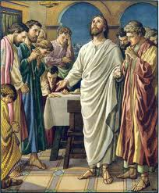
Priestly Prayer
Whole chapter is prayer of Jesus to the Father
Jesus speaks as intercessor
Disciples overhear

Slide 5
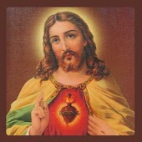
Glorify
Now glorify me, Father (John 17:5)
Now make manifest the power, majesty, nature, and love of God in Jesus.
With the glory that I had with You before the world began (John 17:5)
With the power, majesty, nature, and love of God Jesus had before the world began.

Slide 6
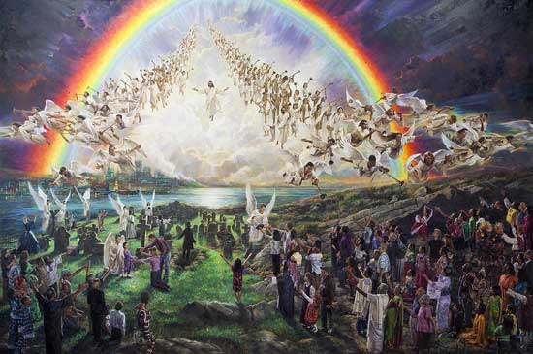
Eternal Life Now this is eternal life, that they should know you, the only true God, and the one whom you sent, Jesus Christ. (John 17:3)
Defined by John
To know God and His Son Jesus Christ
Includes a relational bond of love
John’s only attempt at definition
Major theme of John’s Gospel
Realized eschatology
Greek word is “aionios”
Primarily refers to quality of life
Knowing God is characteristic Old Testament theme
“The earth shall be filled with the knowledge of the Lord’s glory” (Habbakuk 2:14)
Rabbinic teaching was that Amos had reduced all the Law to one commandment: “Seek me, that you may live” (Amos 5:4)

Slide 7
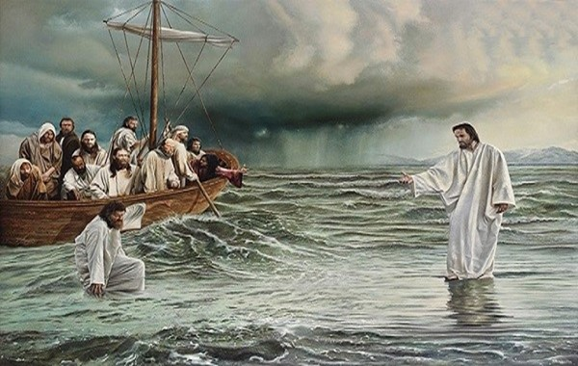
Name I revealed your name to those whom you gave me out of the world. (John 17:6)
Old Testament
Name indicates more than address
Name indicates nature or character
“They trust in you who cherish your name.” (Psalm 9:10)
“Some are strong in chariots; some in horses; But we are strong in the name of the Lord, our God.” (Psalm 20:8)
Jesus revealed the name of God
Jesus revealed the nature and character of God
“Whoever has seen me has seen the Father” (John 14:9)

Slide 8
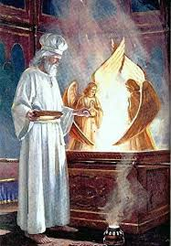
Name I revealed your name to those whom you gave me out of the world. (John 17:6)
Jews referred to the Name of God
YHWH
Stands for YAHWEH [tetragrammaton]
Spoken only by High Priest on the Day of Atonement
We should not speak it
6 times Catechism says it is ineffable
Too holy to pronounce
Do many of us call our parents by their first names?
CCC446 In the Greek translation of the Old Testament, the ineffable Hebrew name YHWH, by which God revealed himself to Moses, is rendered as Kyrios, "Lord". From then on, "Lord" becomes the more usual name by which to indicate the divinity of Israel's God. The New Testament uses this full sense of the title "Lord" both for the Father and — what is new — for Jesus, who is thereby recognized as God Himself.

Slide 9
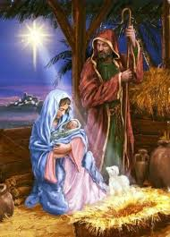
World
Jesus came into the world because God so loved the world (John 3:16)
Different contexts
John 3:16 – His creation – mankind floundering without knowing God

Slide 10

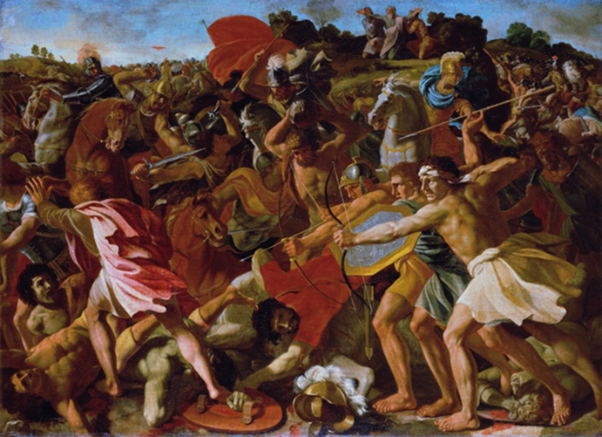
World
Jesus came into the world because God so loved the world (John 3:16)
Different contexts
John 3:16 – His creation – mankind floundering without knowing God
I pray for them. I do not pray for the world but for the ones you have given me, because they are yours, and everything of mine is yours and everything of yours is mine, and I have been glorified in them. (John 17:9-10)
Different contexts
John 17:9 – human society organized without God, self-seeking motivations
Jesus sends the disciples into the world
Lead the world back to God.

Slide 11
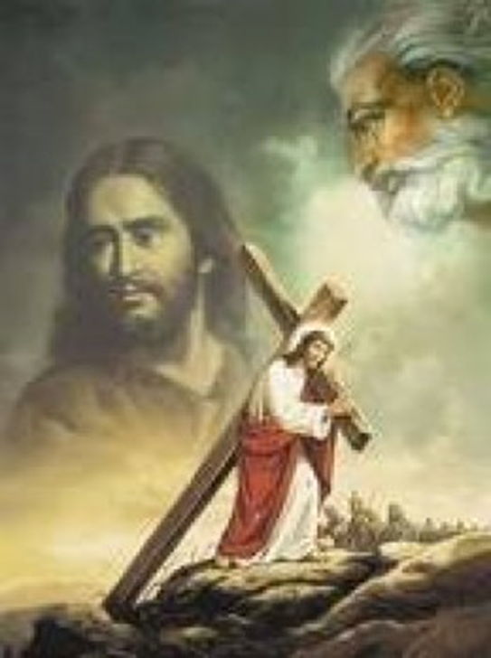
Claim
Now glorify me, Father, with you, with the glory that I had with you before the world began. (John 17:5)
“Just as all that belongs to me is yours, so all that belongs to you is mine.” (John 17:10)
Clear claim to unity and oneness with God
Jesus is one with the Father
Jesus is God

Slide 12
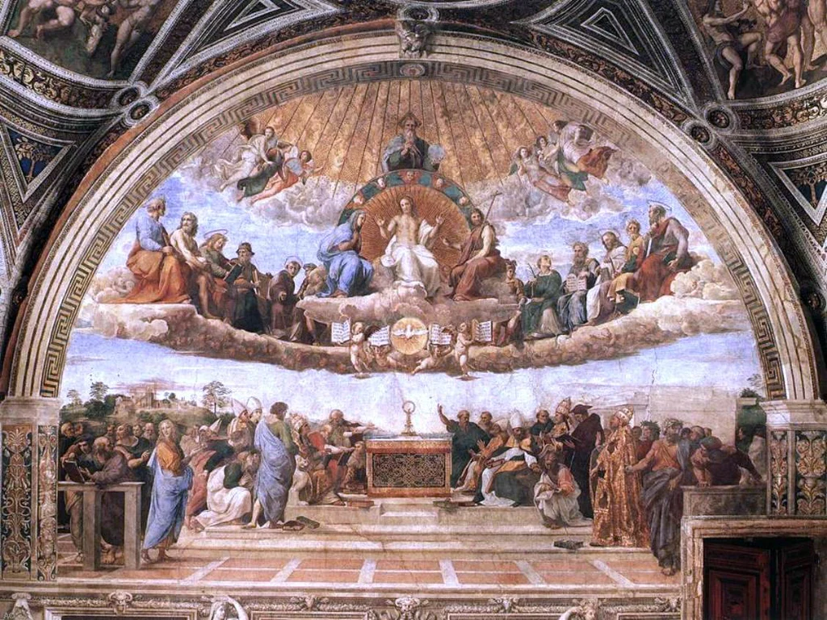
That they may be one
Holy Father, keep them in your name that you have given me, so that they may be one just as we are (John 17:11)
That they may all be one, as you, Father, are in me and I in you, that they also may be in us (John 17:21)
And I have given them the glory you gave me, so that they may be one, as we are one, I in them and you in me, that they may be brought to perfection as one, that the world may know that you sent me, and that you loved them even as you loved me (John 17:22-23)
How can the Apostles be one as Jesus and the Father are one?
They are the Church
God is present in His Church
We are the Church. We became so at our Baptism
The Holy Trinity lives in us
The Body of Christ
Father, Son, and Holy Spirit

Slide 13
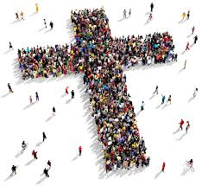
Consecrate Consecrate them in the truth. (John 17:17)
Derived form Greek word – hagios
Usually translated holy
Basic meaning is different or set apart
Means to set apart for a special task
Also means to equip a person with qualities necessary for the task
Perfection
Doesn’t mean without sin or flaw
But, ideally suited for a given task.
That they may be brought to perfection as one. (John 17:23)
God is present in His Church
The Body of Christ
Father, Son, and Holy Spirit

Slide 14
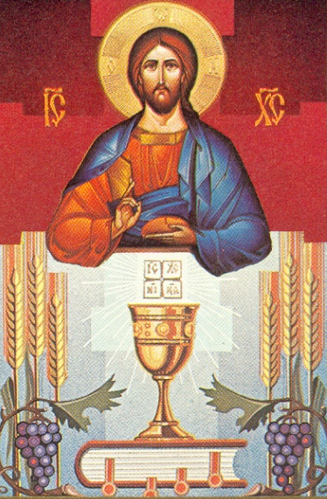
Consecration of the Church Guardian of the Truth
Consecrate them in the truth. Your word is truth. As you sent me into the world, so I sent them into the world. And I consecrate myself for them, so that they also may be consecrated in truth. (John 17:17-19)
Church has been consecrated to the Truth
With Christ present in His Church
Church given authority to determine truth
And the Holy Spirit to guide it
“I am the way, and the truth, and the life.” (John 14:6)
“Your word is truth” (John 17:17)
“In the beginning was the Word and the Word was in God’s presence, and the Word was God” (John 1:1)
Whatever you [Peter] bind on earth shall be bound in heaven; and whatever you loose on earth shall be loosed in heaven.“ (Matthew 16:19)
“Receive the holy Spirit. Whose sins you forgive are forgiven them, and whose sins you retain are retained.” (John 20:23)

Slide 15
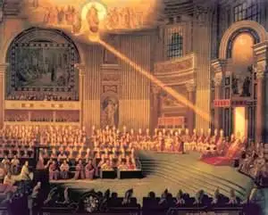
Consecrated in truth
I consecrate myself for them, so that they also may be consecrated in truth. (John 17:17-19)
CCC890 The mission of the Magisterium is linked to the definitive nature of the covenant established by God with his people in Christ.
It is this Magisterium's task to preserve God's people from deviations and defections
and to guarantee them the objective possibility of professing the true faith without error.
Thus, the pastoral duty of the Magisterium is aimed at seeing to it that the People of God abides in the truth that liberates.
To fulfill this service, Christ endowed the Church's shepherds with the charism of infallibility in matters of faith and morals.
30,000 Protestant denominations professing different beliefs cannot possibly all be truth
Infallibility means it cannot fail. It does not mean it cannot sin (impeccability)
"Simon, Simon…I have prayed that your own faith may not fail; and once you have turned back, you must strengthen your brothers. (Luke 22:31-32)

Slide 16
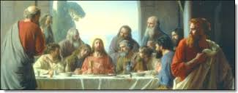
Serpent in the Garden None of them was lost except the son of destruction (John 17:12)
17:12 “the man who must be lost” (NEB)
Man who complained of waste of perfume (John 12:4)
Irony
“Even my friend who had my trust and partook of my bread has raised his heel against me” (Psalm 41:10)
Quoted by Jesus in John 13:18
Prophecy of Judas betrayal

Slide 17
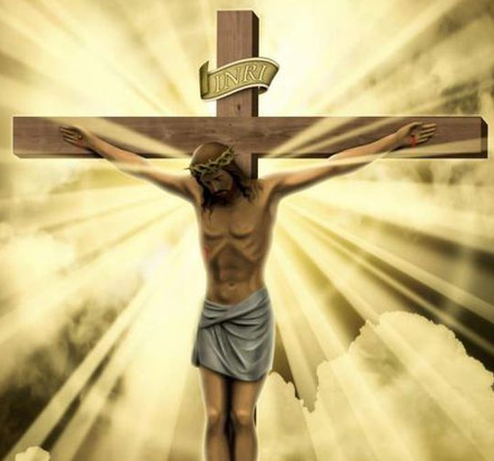
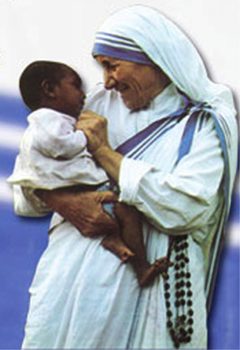
Glory of Jesus
The Cross
Jesus did not speak of being crucified
He spoke of being glorified
And when I am lifted up from the earth, I will draw everyone to myself." (John 12:32)
Christian’s glory is the cross He bears
Obedience
Jesus’ glory was His perfect obedience to the will of the Father
Christians’ glory is doing the will of God rather than our own will.
Recognition of God
Through His word, His deeds, and His life men recognized His relationship with God.
A Christian’s glory is when men see in us the reflection of God.

Slide 18
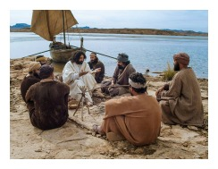
Jesus’ Certainty That the world may know that you sent me (John 17:23)
Prospects were bleak
He had few followers
He was facing humiliating, brutal execution
He would be betrayed by one of His closest friends
All of his followers would abandon or deny Him
They were facing the most powerful empire on earth.
His faith and trust were complete
His disciples would spread the Gospel
His disciples believed in Him
The Gospel would spread throughout the world
The World would see His Church

Slide 19
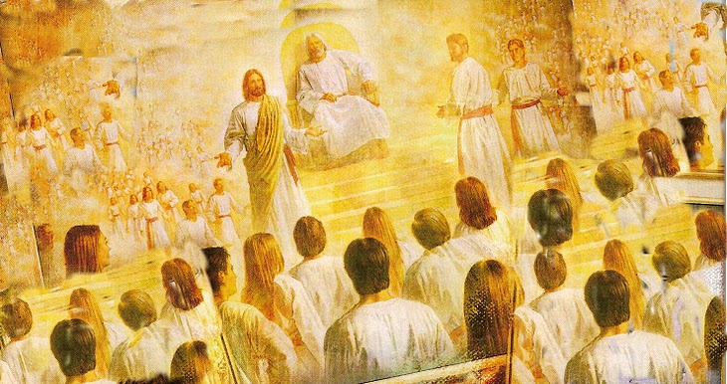
Glory That they may see my glory that you gave me (John 17:24)
If we share Christ’s Cross, we will share His Glory
“If we have died with Him, we shall also live with Him; if we hold out to the end, we shall also reign with Him.” (2 Timothy 2:11-12)

Slide 20
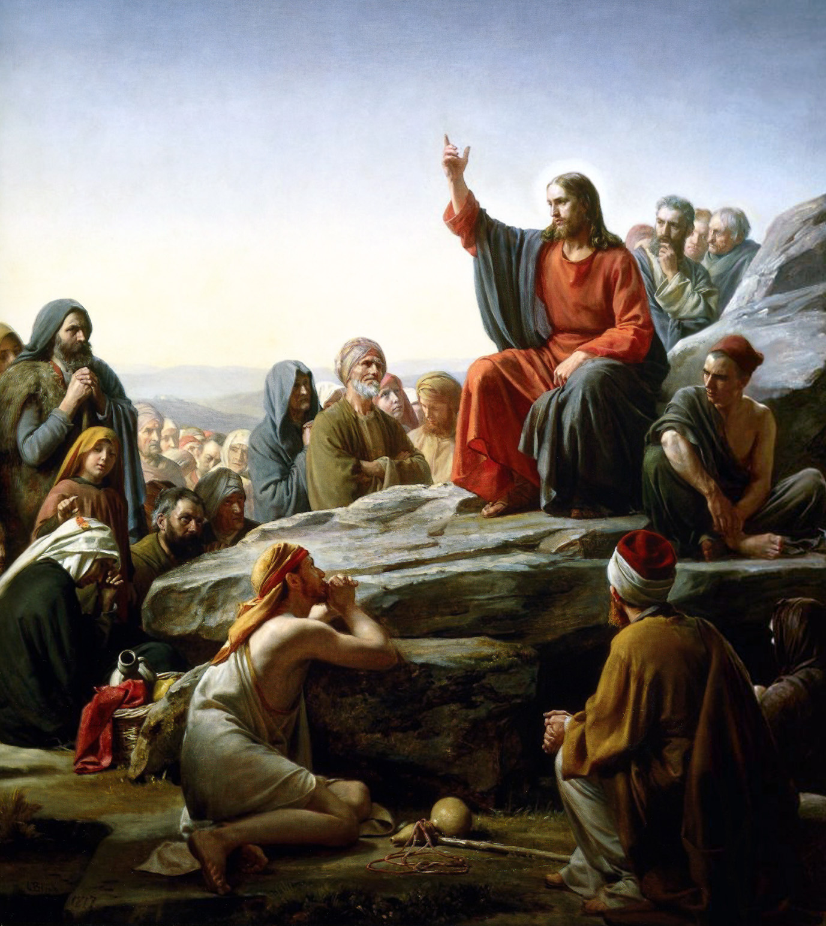
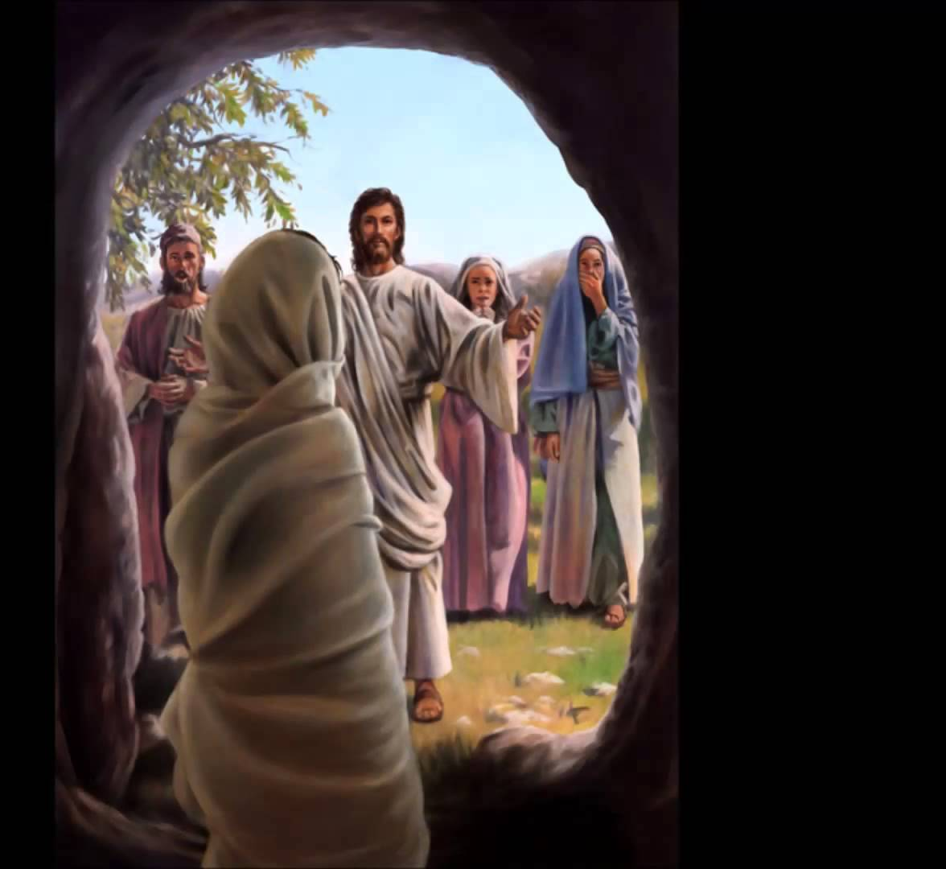

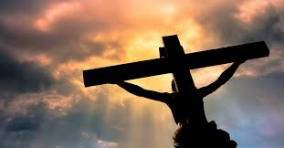
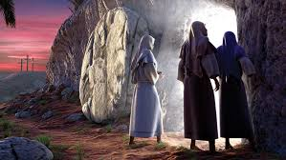
Summary of Christ’s Mission
Righteous Father, the world also does not know you, but I know you, and they know that you sent me. I made known to them your name and I will make it known, that the love with which you loved me may be in them and I in them. (John 17:25-26)
The world did not know God
Jesus revealed God’s nature (name) to the world
Jesus will continue His revelation to men
Jesus will indwell the disciples
Final vision: men who love God and one another
You shall love the Lord, your God (Matthew 22:37)
You shall love your neighbor (Matthew 22:39)

Slide 21
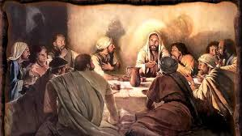
Jesus’ Last Prayer before His Crucifixion
From this prayer Jesus goes directly
To His betrayal
To His trial
To His cross
To the grave
His last words were glory – not despair
To the Resurrection
Reunion with His Disciples
Ascension to Heaven
King of the Universe

Slide 22
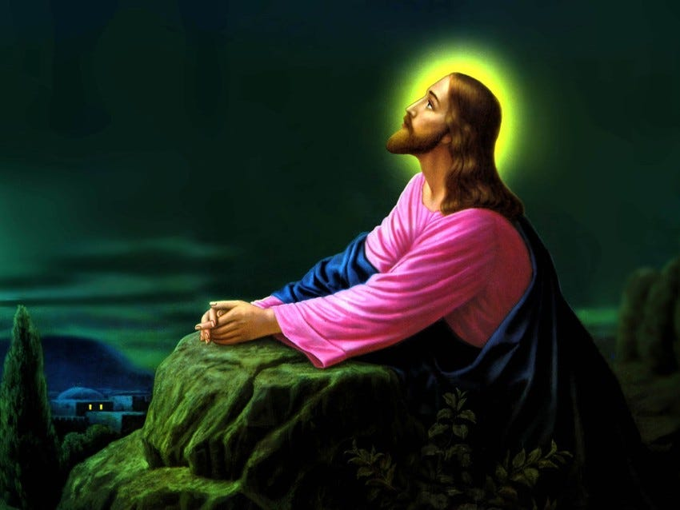
The Lord’s Prayer John 17
Our Father who art in heaven
Jesus looked up to heaven and said: Father…(1)
Hallowed be Thy name
O Father most holy (11)
Thy kingdom come
All those who you gave me I would have in my company where I am to see this glory of mine (24)
Thy will be done on earth as it is in heaven
These men you gave me were yours; they have kept your word (17)

Slide 23
The Lord’s Prayer John 17
Give us this day our daily bread
Consecrate them by means of truth–your word is truth (17)
And forgive us our trespasses as we forgive those who trespass against us
I have given them the glory that you gave me that they may be one, as we are one – I living in them, you living in me – that their unity may be complete (22-23)
Deliver us not into temptation
They do not belong to the world (14)
But deliver us from evil
But guard them from the evil one (15)

Slide 24
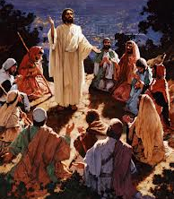
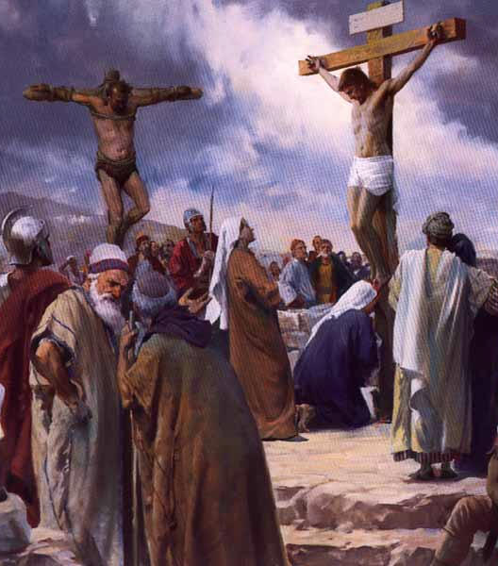
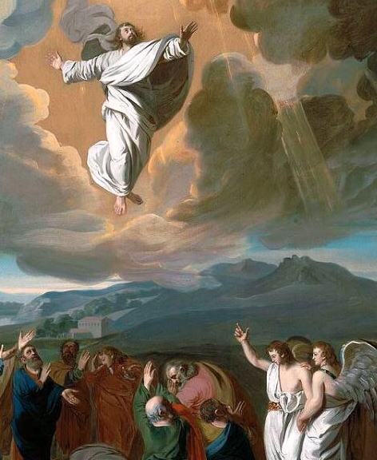
Road to Glory
When Jesus had said this, he raised his eyes to heaven and said, "Father, the hour has come. Give glory to your son, so that your son may glorify you (John 17:1)
Jesus knew what was coming
Jesus spoken before of being lifted up
And when I am lifted up from the earth, I will draw everyone to myself.“ (John 12:32)
He is fulfilling Jeremiah’s prophecy
"The place is to remain unknown until God gathers his people together again and shows them mercy (2 Maccabees 2:7)

Slide 25
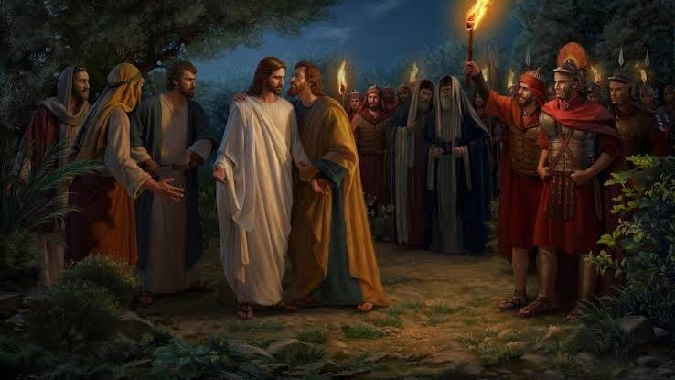
Betrayal
Betrayal
2 Judas his betrayer also knew the place, because Jesus had often met there with his disciples. 3 So Judas got a band of soldiers and guards from the chief priests and the Pharisees and went there with lanterns, torches, and weapons.
Fn. SIB 18:3 band of soldiers: A detachment (cohort) of several hundred Roman troops [cohort, typically, ~650 counting staff]
This appears excessive. More likely, a detachment from the cohort stationed in the Praetorium
It is possible, also, that the soldiers were temple guards and not Roman; or maybe both
We see this ambiguity when the priests request soldiers to prevent the Resurrection.

Slide 26
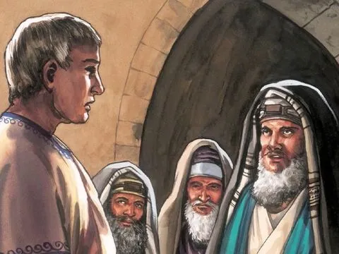
Pilate and the Priests
The next day, the one following the day of preparation [Saturday], the chief priests and the Pharisees gathered before Pilate and said, “Sir, we remember that this impostor while still alive said, ‘After three days I will be raised up.’ Give orders, then, that the grave be secured until the third day, lest his disciples come and steal him and say to the people, ‘He has been raised from the dead.’ This last imposture would be worse than the first.” Pilate said to them, “The guard is yours; go secure it as best you can.” (Matthew 27:62-65)
The guard is yours: literally, “have a guard” or “you have a guard.” Either the imperative or the indicative could mean that Pilate granted the petitioners some Roman soldiers as guards, which is the sense of the present translation. However, if the verb is taken as an indicative, it could also mean that Pilate told them to use their own Jewish guards.
Put your self in Pilate’s position.
He is unlikely to me worried about the Resurrection
Romans knew how to kill, permanently
His troops have done enough

Slide 27
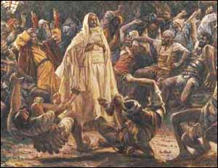
Arrest
So, Judas got a band of soldiers and guards from the chief priests and the Pharisees and went there with lanterns, torches, and weapons. Jesus, knowing everything that was going to happen to him, went out and said to them, "Whom are you looking for?" They answered him, "Jesus the Nazorean." He said to them, "I AM." Judas his betrayer was also with them. When he said to them, "I AM," they turned away and fell to the ground. So, he again asked them, "Whom are you looking for?" They said, "Jesus the Nazorean.“ Jesus answered, "I told you that I AM. So, if you are looking for me, let these men go.“ (John 18:3-8)
Jesus is in control
For this I was born and for this I came into the world, to testify to the truth. Everyone who belongs to the truth listens to my voice.“ (John 18:16)

Slide 28
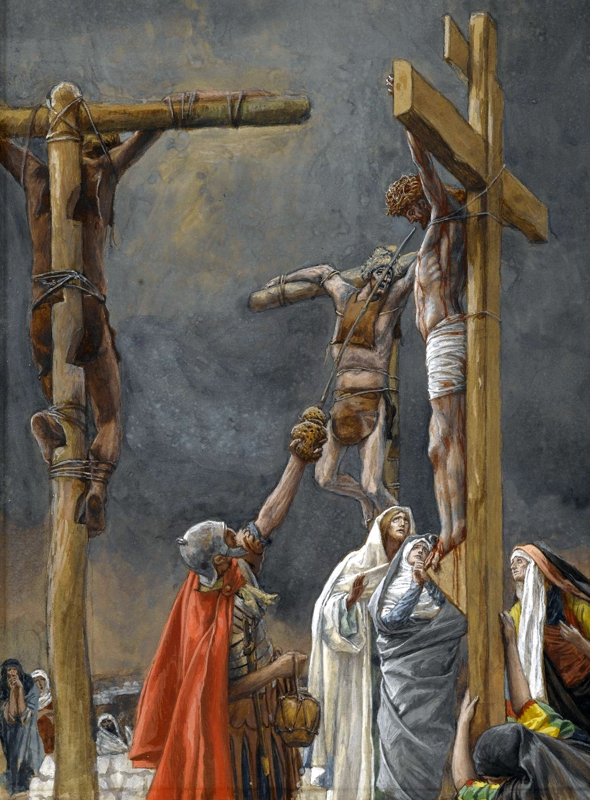
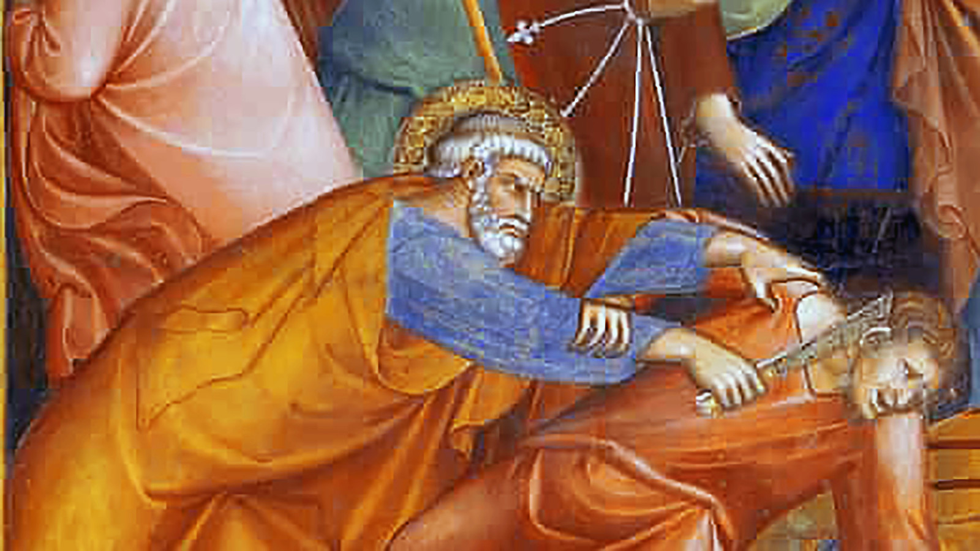
Peter’s Defense of Jesus
Then Simon Peter, who had a sword, drew it, struck the high priest's slave, and cut off his right ear. The slave's name was Malchus. Jesus said to Peter, "Put your sword into its scabbard. Shall I not drink the cup that the Father gave me?“ (John 18:10-11)
At the Last Supper, Jesus and the Apostles left for Gethsemane without drinking the Fourth Cup, the Cup of Consummation.
Jesus heals even one of those arresting Him
Jesus will drink that cup on the cross
We will see that next week

Slide 29
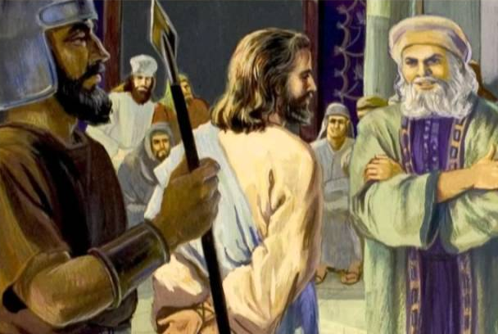
Jesus before the High Priest(s)
So, the band of soldiers, the tribune, and the Jewish guards seized Jesus, bound him, and brought him to Annas first. He was the father-in-law of Caiaphas, who was high priest that year. It was Caiaphas who had counseled the Jews that it was better that one man should die rather than the people. (John 18:12-14)
Note the presence of a Roman tribune indicating, at least some Roman soldiers were present at the arrest of Jesus at Gethsemane.
Annas had been high priest before Caiaphas, his son-in-law
The trial before the Sanhedrin is not repeated in John’s Gospel; only the results when they send Him Pilate in the morning.

Slide 30
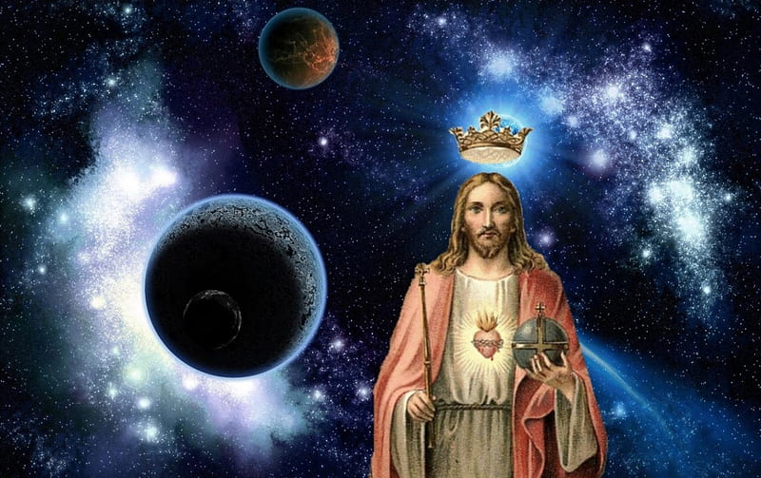
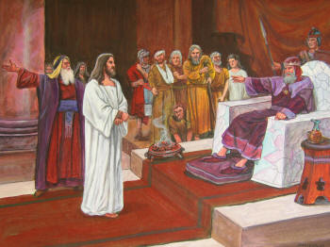
Jesus, King of the Universe on Trial
But now I am coming to you. I speak this in the world so that they may share my joy completely. I gave them your word, and the world hated them, because they do not belong to the world any more than I belong to the world. I do not ask that you take them out of the world but that you keep them from the evil one. They do not belong to the world any more than I belong to the world.
Consecrate them in the truth. Your word is truth. As you sent me into the world, so I sent them into the world. And, I consecrate myself for them, so that they also may be consecrated in truth. (John 17:13-19)

