Slide 1
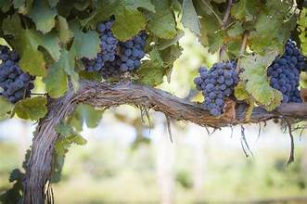
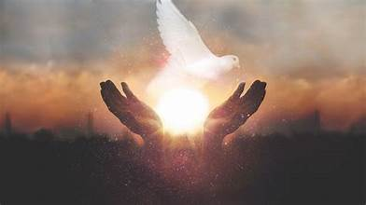
JOHN 15 -16
I AM THE TRUE VINE
THE ACTION OF THE HOLY SPIRIT
Notes:
We are reviewing John chapters 15 & 16 today.
Before we begin, I’m goin to take you to the last sentence in cht 14.. It says:

Slide 2
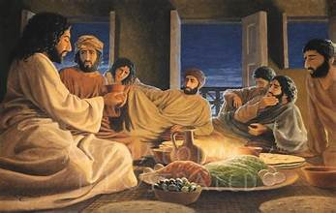

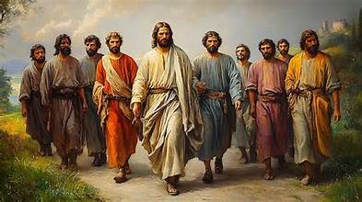

JOHN 14:31
31 but the world must know that I love the Father and that I do just as the Father has commanded me. Get up, let us go
Notes:
READ
But in the next chapter and for 2 more chapters, Jesus keeps talking. It is only in Chapter 18 that he gets to where he is going
.3 scenarios that might be a possible answer as to why cpt 14 appears out of order.:
*scrolls out of order,
*walking & talking
*or after a long supper as they are starting to get up and get ready, Jesus decides he must tell them more to help them understand and they sit back down & listen.

Slide 3
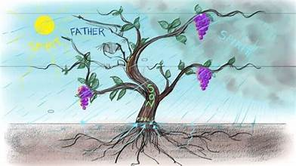
JOHN 15:1
1 “I am the true vine, and my Father is the vine grower.
^{Psalm 80 :8-11}
⁸ You brought a vine out of Egypt;
you drove out the nations and planted it.
⁹ You cleared the ground for it;
it took deep root and filled the land.
¹⁰ The mountains were covered with its shade,
the mighty cedars with its branches;
¹¹ it sent out its branches to the sea,
and its shoots to the River.
Notes:
READ This would have been a problem for a Jewish person at the time.
At this time based on Jewish scripture the nation of Israel is considered the vine of God. I’m going to give you 2 examples in Jewish scripture where this is cleary evident. From psalm 80 we have *

Slide 4
JOHN 15:1
1 “I am the true vine, and my Father is the vine grower.
⁶ I will make it a waste;
it shall not be pruned or hoed,
and it shall be overgrown with briers and thorns;
I will also command the clouds
that they rain no rain upon it.
⁷ For the vineyard of the Lord of hosts
is the house of Israel,
and the people of Judah
are his pleasant planting;
he expected justice,
but saw bloodshed;
righteousness,
but heard a cry!
Isaiah 5:1-7
Let me sing for my beloved
my love-song concerning his vineyard:
My beloved had a vineyard
on a very fertile hill.
² He dug it and cleared it of stones,
and planted it with choice vines;
he built a watchtower in the midst of it,
and hewed out a wine vat in it;
he expected it to yield grapes,
but it yielded wild grapes.
³ And now, inhabitants of Jerusalem
and people of Judah,
judge between me
and my vineyard.
⁴ What more was there to do for my vineyard
that I have not done in it?
When I expected it to yield grapes,
why did it yield wild grapes?
⁵ And now I will tell you
what I will do to my vineyard.
I will remove its hedge,
and it shall be devoured;
I will break down its wall,
and it shall be trampled down.
Notes:
An admonishment from Isaia 5 – The Song of the Unfruitful Vineyard says: **

Slide 5
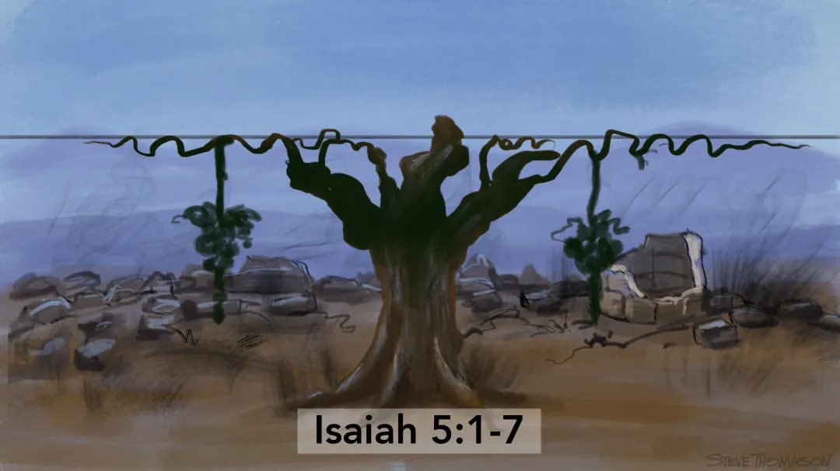

Notes:
We see now there is a new true vine. The old vine, still are the people of Israel. * the new true vine * is Jesus

Slide 6
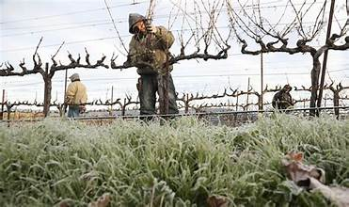
JOHN 15:2-3
² He takes away every branch in me that does not bear fruit, and every one that does he prunes so that it bears more fruit. ³ You are already pruned because of the word that I spoke to you.
A branch that separates itself from the vine or starts growing wildly is of no use to the grower
Even a branch producing fruit, needs to be pruned to be able to produce even more fruit.
Pruning = Being made Clean/Purification
Faith to start. Then works are needed
Notes:
As he does often to help people better understand, Jesus uses imagery and parables.
RED *John while recounting what Jesus said, is even more specifically speaking to his audience, bothe at the time of his writing and to us. This is a reminder that separating yourself from God or doing what one please while saying you are faithful, will result in separation from God.
YELLOW *When pruned, cuts are made, painful,stops growth in a particular area, calusses form. The vine is given direction. And then only can it become more fruitful. Jesus is talking about us
WHITE *We see here that faith, being part of the vine is not enough. Works are needed fot it to be fruitful *

Slide 7
JOHN 15:4-5
⁴ Remain in me, as I remain in you. Just as a branch cannot bear fruit on its own unless it remains on the vine, so neither can you unless you remain in me. ⁵ I am the vine, you are the branches. Whoever remains in me and I in him will bear much fruit, because without me you can do nothing.
A Matter of Choice
The only way to be fruitful is to remain on the vine
Notes:
RED *
Read *
It is impossible to bear any fruit if not connected to the vine.
The new vine is Jesus
Only with Jesus can you bear much fruit and that fruit will have seeds that can bear even more fruit.

Slide 8
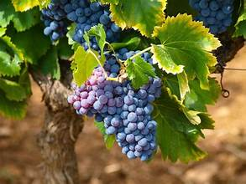
JOHN 15:6-8
⁶ Anyone who does not remain in me will be thrown out like a branch and wither; people will gather them and throw them into a fire and they will be burned. ⁷ If you remain in me and my words remain in you, ask for whatever you want and it will be done for you. ⁸ By this is my Father glorified, that you bear much fruit and become my disciples
Emphasis here is in abiding,
Not the amount of fruit one bears
He is very specific as to the result of not abiding
“It becomes safe for God to say to the sanctified soul, ‘Ask what thou wilt, and it shall be done unto thee.’ The heavenly instincts of that man lead him right; the grace that is within his soul thrusts down all covetous lustings and foul desires, and his will is the actual shadow of God’s will. The spiritual life is master in him, and so his aspirations are holy, heavenly, Godlike.” (Spurgeon)
Notes:
Red * Yellow * green *
When we are aligned with God, what we ask will not be centered on our earthly desires but will be inlie with God’s desires.
This is not a competition. God treats us all as individuals doing our best. WHITE
Spurgeon – Baptist commenatator in London in the late 1800’s

Slide 9
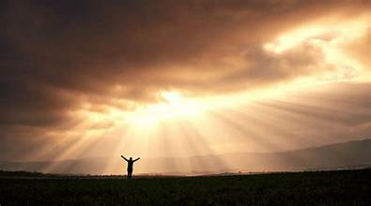
JOHN 15:9-11
⁹ As the Father loves me, so I also love you. Remain in my love. ¹⁰ If you keep my commandments, you will remain in my love, just as I have kept my Father’s commandments and remain in his love.
¹¹ “I have told you this so that my joy may be in you and your joy may be complete.
There is a link between Love and obedience
The love of God was freely given to Jesus who freely gave it to us
Jesus connects true discipleship with obedience to God’s command and honoring God’s Word.
Jesus fulfilled this with regards to His Father and now the disciples are asked to follow his lead and fulfill it with respect to Jesus.
The Joy of Jesus is the joy of being right with God and consciously walking in His love and care.
Notes:
READ
Jesus does not ask the disciples for more tha he is ready to do and to follow hos example. We see: *

Slide 10
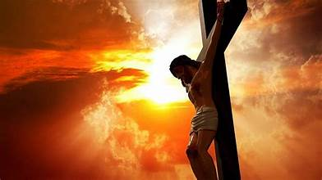
JOHN 15:12-15
FRIEND
Obedient to his commands
True partners (vs a slave who can become a trusted acquaintance but never a partner)
Jesus has never kept secrets from them and has openly revealed what he has learned from the Father
¹² This is my commandment: love one another as I love you. ¹³ No one has greater love than this, to lay down one’s life for one’s friends. ¹⁴ You are my friends if you do what I command you. ¹⁵ I no longer call you slaves, because a slave does not know what his master is doing. I have called you friends, because I have told you everything I have heard from my Father.
Notes:
Now Jesus moves on and begins a section about how they are to relate to eachother when he leaves.
READ
Ther are no explicit directions from Jesus and no reiterating of any of the various Jewish laws. Just one instruction. And they are to follow his example. Love one another
Jesus calls his apostles friends and tells them why. ****

Slide 11
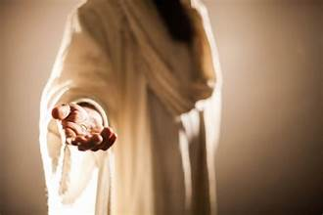
JOHN 15:16-17
16 It was not you who chose me, but I who chose you and appointed you to go bear fruit that will remainand, so that whatever you ask the Father in my name he may give you. 17 This I command you: love one another.
We do not call God. God calls us
Action is required
The result of the action will be fruit
Fruit bearing will result in answered prayer
Notes:
Jesus reminds the apostles not to get too haughty BLUE *
At the time, a disciple looked around and chose a rabbi, and then followed him. Jeus specifically chose his disciples just as he specifically calls to us.
RED * YELLOW * GREEN * READ

Slide 12
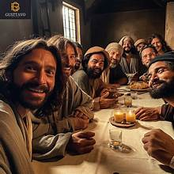
PRIVILEGES OF THE DISCIPLES
Friendship with the Master
Answered prayer
Bearing much fruit
Knowing things from the Father
Notes:
Jesus has spelled out for the disciple the privileges of discipleship.
So what are the privileges of the Disciples of Jesus ****
He will now spell out the difficulties

Slide 13
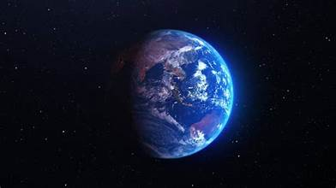
JOHN 15:18-20
Warning of Rejection
Jesus has warned them of his rejection
Because they will follow him they also will be rejected
There is no compromise between the Kingdom of God and the Kingdom of Sin (the world)
¹⁸ “If the world hates you, realize that it hated me first. ¹⁹ If you belonged to the world, the world would love its own; but because you do not belong to the world, and I have chosen you out of the world, the world hates you. ²⁰ Remember the word I spoke to you, ‘No slave is greater than his master.’ If they persecuted me, they will also persecute you. If they kept my word, they will also keep yours.
Irony:
They will pay the same attention to your words as to mine - none
Notes:
READ
****John is writing down the warnings Jesus gave to his own apostles, but John is also writing to a specific persecuted audience and to us too. He throws in a bit of irony here.
*

Slide 14
²¹ And they will do all these things to you on account of my name, because they do not know the one who sent me. ²² If I had not come and spoken to them, they would have no sin; but as it is they have no excuse for their sin. ²³ Whoever hates me also hates my Father. ²⁴ If I had not done works among them that no one else ever did, they would not have sin; but as it is, they have seen and hated both me and my Father. ²⁵ But in order that the word written in their law might be fulfilled, ‘They hated me without cause.’
JOHN 15:21-25
They do not know God as He really is, so attack His messenger
Jesus can be recognized through:
His Words
His Works
Scripture
Notes:
Read yellow * But..* read colors & *

Slide 15
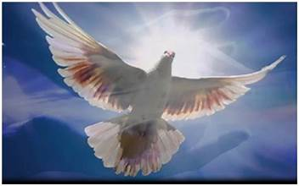
JOHN 15:26-27
²⁶ “When the Advocate comes whom I will send you from the Father, the Spirit of truth that proceeds from the Father, he will testify to me. ²⁷ And you also testify, because you have been with me from the beginning.
The promise of a Helper
Notes:
Proceede from the father & the son

Slide 16
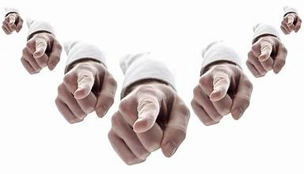
JOHN 16: 1-4
¹ “I have told you this so that you may not fall away. ² They will expel you from the synagogues; in fact, the hour is coming when everyone who kills you will think he is offering worship to God. ³ They will do this because they have not known either the Father or me. ⁴ I have told you this so that when their hour comes you may remember that I told you. . I did not tell you this from the beginning, because I was with you.
Forewarning
Expulsion
Execution in the name of God
Jesus Death
Notes:
As we begin chapter 16, we see Jesus still trying to prepare his apostles for what is coming READ
This is the forwarning : Be prepared for: ***

Slide 17
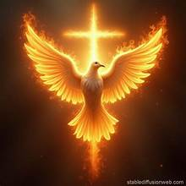
JOHN 16: 5-7
²⁶ “When the Advocate comes whom I will send you from the Father, the Spirit of truth that proceeds from the Father, he will testify to me. JN 15:26
⁵ But now I am going to the one who sent me, and not one of you asks me, ‘Where are you going?’ ⁶ But because I told you this, grief has filled your hearts.
¹⁵ “If you love me, you will keep my commandments. ¹⁶ And I will ask the Father, and he will give you another Advocate, to be with you forever.
JN 14:15-16
⁷ But I tell you the truth, it is better for you that I go. For if I do not go, the Advocate will not come to you. But if I go, I will send him to you
²⁶ But the Advocate, the Holy Spirit, whom the Father will send in my name, will teach you everything, and remind you of all that I have said to you.
JN 14:26
Notes:
Jesus is also preparing them for his departure READ
In John 13 Peter did ask where Jesus was going, but with the intention to follow, In John 14 Thomas asked in order to figure out a way to follow. They are not asking now because they understand that they cannot follow, and in understanding what this maens are full of sorrow, which Jesus recognizes. *
Jesus speaks of the advocate few times .****
Each time he stresses that he must leave for a permanent advocate to come to be with them forever. The withdrawl of the human Jesus is necessary of a permanat spiritual presence. God wants us to walk by faith, and not by sight, and if Jesus were here bodily, there would be great temptation to walk by sight, and not by faith. Truly, it is better for you that I Go

Slide 18
JOHN 16: 8-11
⁸ And when he comes he will convict the world in regard to sin and righteousness and condemnation: ⁹ sin, because they do not believe in me; ¹⁰ righteousness, because I am going to the Father and you will no longer see me; ¹¹ condemnation, because the ruler of this world has been condemned.
Legal term, expose, refute, convince
The essence of sin is unbelief’.
The Truth about God
A final judgement of Satan
Normally conviction is followed by judgment. When the Holy Spirit works, there is an in-between step: the revelation of the righteousness of Jesus Christ, which can satisfy the judgment for the convicted person. (Enduring Word)
Notes:
Read to RED * then say: Convict with regards to sin * convict with…..

Slide 19

JOHN 16: 12-15
Gifts of the Holy Spirit
¹² “I have much more to tell you, but you cannot bear it now. ¹³ But when he comes, the Spirit of truth, he will guide you to all truth. He will not speak on his own, but he will speak what he hears, and will declare to you the things that are coming. ¹⁴ He will glorify me, because he will take from what is mine and declare it to you. ¹⁵ Everything that the Father has is mine; for this reason I told you that he will take from what is mine and declare it to you.
Fruits of the Holy Spirit
Notes:
READ Jesus is talking about *
When we look at our vineyard, the father as the vineyard owner takes care of his vine, the son, and with the gifts of the holy spirit, the branches become fruitful.

Slide 20
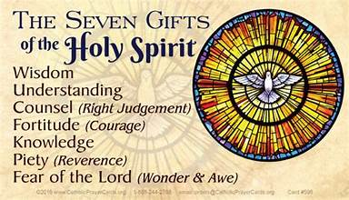
Notes:
We don’t often talk about what the holy spirit does for us., so I thought we could take a quick refresh as to what Jesus is promising the apostles, and what both John’s audience and us receive from the Holy spirit.
READ. These are the gifts. We however need to use them. And when we do.

Slide 21
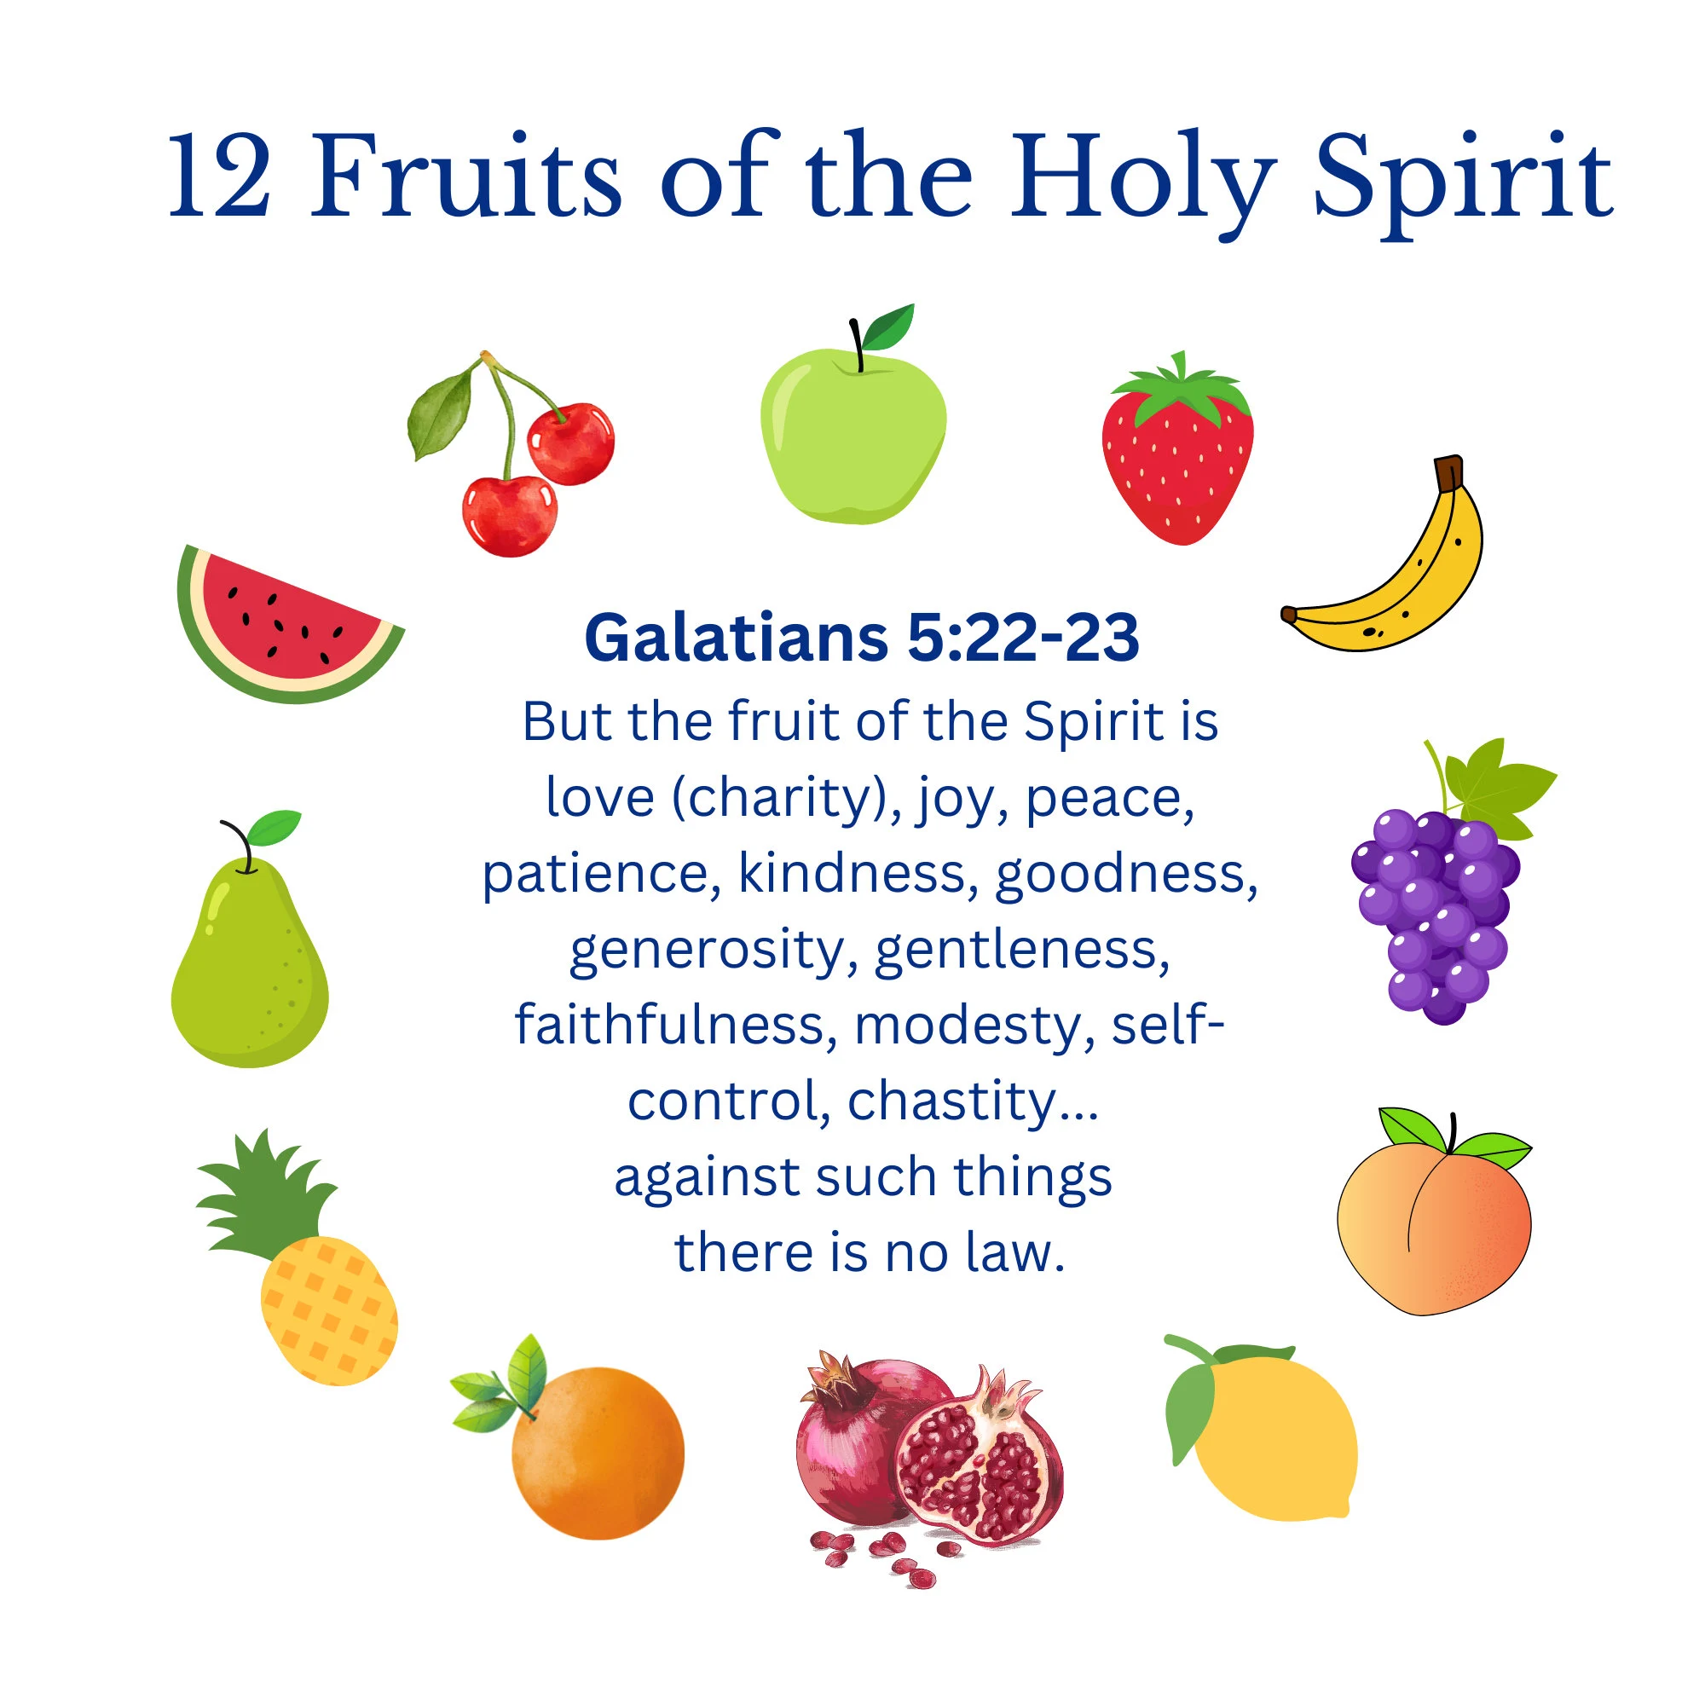
Notes:
Just as that pruned branch attached to the one true vine, we get the 12 fruits of the holy spirit

Slide 22
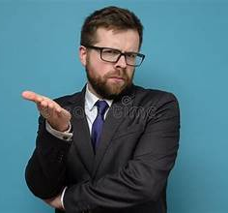
JOHN 16: 12-15
The Apostles are confused
¹⁶ “A little while and you will no longer see me, and again a little while later and you will see me.” ¹⁷ So some of his disciples said to one another, “What does this mean that he is saying to us, ‘A little while and you will not see me, and again a little while and you will see me,’ and ‘Because I am going to the Father’?” ¹⁸ So they said, “What is this ‘little while’ [of which he speaks]? We do not know what he means.”

Slide 23
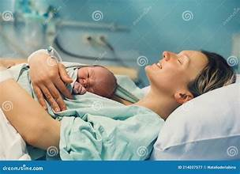
JOHN 16: 19-22
¹⁹ Jesus knew that they wanted to ask him, so he said to them, “Are you discussing with one another what I said, ‘A little while and you will not see me, and again a little while and you will see me’? ²⁰ Amen, amen, I say to you, you will weep and mourn, while the world rejoices; you will grieve, but your grief will become joy. ²¹ When a woman is in labor, she is in anguish because her hour has arrived; but when she has given birth to a child, she no longer remembers the pain because of her joy that a child has been born into the world. ²² So you also are now in anguish. But I will see you again, and your hearts will rejoice, and no one will take your joy away from you.
There will be a lot of pain
The result will be worth it
Notes:
Jesus knows they are confused, and as he often does, uses a parable to make his meaning easier to understand. This parable also has meaning for John’s persecuted audience

Slide 24
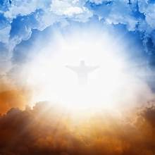
JOHN 16: 23-27
²³ On that day you will not question me about anything. Amen, amen, I say to you, whatever you ask the Father in my name he will give you. ²⁴ Until now you have not asked anything in my name; ask and you will receive, so that your joy may be complete.
²⁵ “I have told you this in figures of speech. The hour is coming when I will no longer speak to you in figures but I will tell you clearly about the Father. ²⁶ On that day you will ask in my name, and I do not tell you that I will ask the Father for you. ²⁷ For the Father himself loves you, because you have loved me and have come to believe that I came from God.
Jesus is the ultimate intermediary to the Father
“Here Jesus is saying: ‘You can go to God, because he loves you,’ and he is saying that before the Cross. He did not die to change God into love; he died to tell us that God is love. He came, not because God so hated the world, but because he so loved the world. Jesus brought to men the love of God.” (Barclay)

Slide 25
JOHN 16: 28-32
Summary of the mystery of the Incarnation
²⁸ I came from the Father and have come into the world. Now I am leaving the world and going back to the Father.” ²⁹ His disciples said, “Now you are talking plainly, and not in any figure of speech. ³⁰ Now we realize that you know everything and that you do not need to have anyone question you. Because of this we believe that you came from God.” ³¹ Jesus answered them, “Do you believe now? ³² Behold, the hour is coming and has arrived when each of you will be scattered to his own home and you will leave me alone. But I am not alone, because the Father is with me.
Spontaneou confession of faith
Rebuke on how long it took them to figure it out
A warning that their faith is still fragile
Notes:
RED * WHITE – and the apostles get it. Yellow * WHITE *

Slide 26

JOHN 16: 33
The Second Vatican Council teaches in connection with this passage: The Lord Jesus Christ who said “ Be of good cheer, I have overcome the world”, did not by these words promise complete victory to his Church in this world. This sacred Council rejoices that the earth which has been sown with the seed of the Gospel is now bringing forth fruit in many places under the guidance of the Spirit of the Lord, who is filling the world” (Presbyterorum ordinis, 22) (Navarre)
³³ I have told you this so that you might have peace in me. In the world you will have trouble, but take courage, I have conquered the world.”
Notes:
And we come to the end of chapter 16

Slide 27
Reflection
⁴ Remain in me, as I remain in you. Just as a branch cannot bear fruit on its own unless it remains on the vine, so neither can you unless you remain in me. ⁵ I am the vine, you are the branches. Whoever remains in me and I in him will bear much fruit, because without me you can do nothing. JN 15:4-5
¹² This is my commandment: love one another as I love you. ¹³ No one has greater love than this, to lay down one’s life for one’s friends. JN 15:12-13
¹³ But when he comes, the Spirit of truth, he will guide you to all truth. He will not speak on his own, but he will speak what he hears, and will declare to you the things that are coming.JN 16:13
Notes:
This has been a long lesson but full of wonderful reflections. I am leaving you with 3 that I especially like

Slide 28
PRAYER FOR THE TWELVE FRUITS OF THE HOLY SPIRIT
HOLY SPIRIT, eternal Love of the Father and the Son, kindly bestow on us the fruit of CHARITY, that we may be united to you by divine love; the fruit of JOY, that we may be filled with holy consolation; the fruit of PEACE, that we may enjoy tranquility of soul; and the fruit of PATIENCE, that we may endure humbly everything that may be opposed to our own desires.
DIVINE SPIRIT, be pleased to infuse in us the fruit of KINDNESS, that we may willingly relieve our neighbor's necessities; the fruit of GOODNESS, that we may be benevolent toward all; the fruit of LONG-SUFFERING, that we may not be discouraged by delay but may persevere in prayer; and the fruit of HUMILITY, that we may subdue every rising of ill temper, stifle every murmur, and repress the susceptibilities of our nature in all our dealings with our neighbor.
CREATOR SPIRIT, graciously impart to us the fruit of FIDELITY, that we may rely with assured confidence on the word of God; the fruit of MODESTY, that we may order our exterior regularly; and the fruits of CONTINENCE and CHASTITY, that we may keep our bodies in such holiness as befits your temple, so that having by your assistance preserved our hearts pure on earth, we may merit in Jesus Christ, according to the words of the Gospel, to see God eternally in the glory of his kingdom.
AMEN
Source: FB - Pray The Holy Rosary Daily

