Slide 1
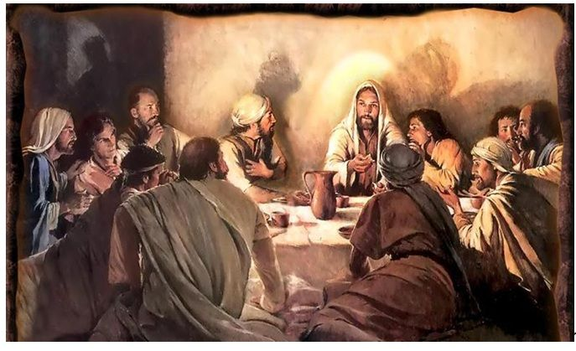
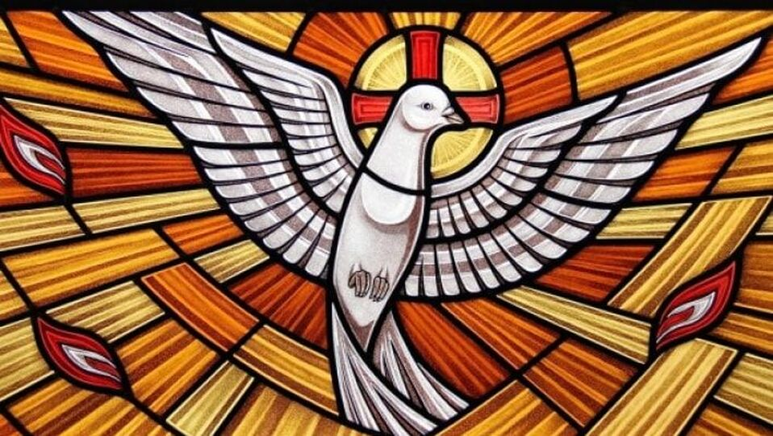

John 14
Jesus, The Way, the Truth, and the Life
The Promise of the Holy Spirit

Slide 2
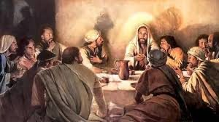
In our last lesson…
Gathered in the upper room after the Last Supper.
Judas left to betray Jesus.
Jesus announced that He is going away, to a place where they cannot go.
Jesus gave them a new commandment: Love one another as I have loved you.
He also revealed to Peter that Peter would deny Jesus three times.
Notes:
Star 1 – this is why the disciples are troubled. They have left their fishing boats and nets their families their way of life to follow Jesus. They believe He is the Son of God. And he is going to leave them? Now what do they do?
2. This is where our lesson today begins.

Slide 3
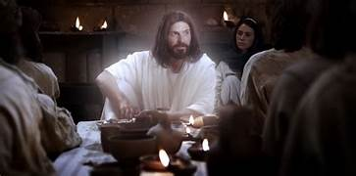
John 14:1-14
Highlights
Still in the upper room after sharing The Last Supper
“Let not your hearts be troubled”
“I go to prepare a place for you”
“I will come again”
“I Am the Way, the Truth and the Life”
“Whoever has seen me has seen the Father”
“If you ask me anything in my name, I will do it.”

Slide 4
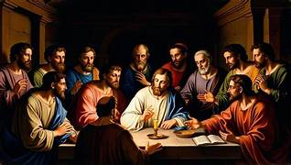
John 14
The Apostles question Jesus-
They are bold enough to ask about what they do not understand.
  Peter 13:35 “Master, where are you going?”
  Thomas 14:5 “Master, we do not know where you are going; how can we know the way?”
  Philip 14:8 “Master, show us the Father, and that will be enough for us.”
  Judas (not Iscariot) 14:22 “But, Lord, why do you intend to show yourself to us and not to the world?”

Slide 5
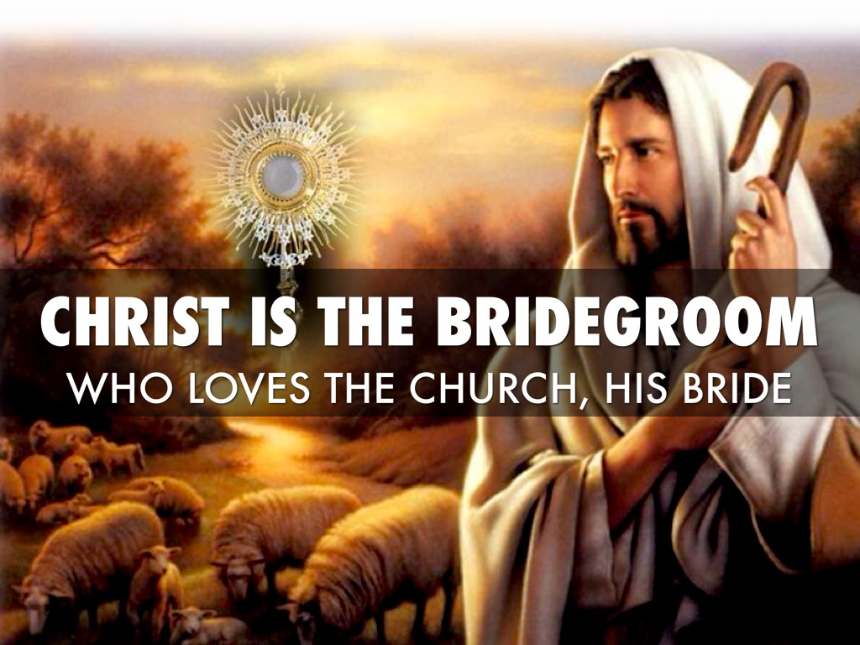
John 14:1-3
Jesus uses language that describes how a 1st century Jewish wedding is planned.
The groom goes away for a while to prepare a place for his bride in his “father’s house.” When it is ready the groom returns to his betrothed and takes her to the place he has prepared for her.
¹ “Do not let your hearts be troubled. You have faith in God; have faith also in me.
² In my Father’s house there are many dwelling places. If there were not, would I have told you that I am going to prepare a place for you? ³ And if I go and prepare a place for you, I will come back again and take you to myself, so that where I am you also may be. ⁴
1
2
Notes:
1 The disciples are uncertain about their future or the future of this community if Jesus leaves them. Jesus comforts them. Do not trouble your hearts. Believe in me. They should recall the miracles and signs they have witnessed and know that He is God. God is never not in control.
2. Isn’t this appropriate? The Church is often described as the bride of Christ. Just as there was a betrothal period in biblical times during which the bride and groom were separated until the wedding, so is the bride of Christ separate from her Bridegroom during the church age.
Her responsibility during the betrothal period is to be faithful to Him.
The dwelling places or homes were often shared with many family members. Some translations use the word “mansions” instead of dwelling place. That is not what the Greek word implies. But the word may be used more as an interpretation of what heaven is thought to be like.

Slide 6
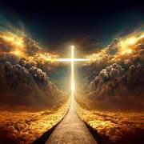
John 14:4-6
Where [I] am going you know the way.”
⁵ Thomas said to him, “Master, we do not know where you are going; how can we know the way?”
⁶ Jesus said to him, “I am the way and the truth and the life.
No one comes to the Father except through me.
Notes:
1Thomas is often depicted as the doubter, but in an earlier chapter he was willing to face death to follow Jesus. Here he is asking a question. He does not know where Jesus is going.
2. The English does not have the same meaning as the Greek or Hebrew understanding of these words, so lets look at them a bit closer

Slide 7
The “way to God” is a well-worn road or path in the OT.
Isaiah 35:8
A highway will be there,
called the holy way;
No one unclean may pass over it,
but it will be for his people;
no traveler, not even fools, shall go astray on it.
Deut 5:32-33 Be careful, therefore, to do as the Lord, your God, has commanded you, not turning aside to the right or to the left, ³³ but following exactly the way that the Lord, your God, commanded you that you may live and prosper, and may have long life in the land which you are to possess.
Deut 31:29 For I know that after my death you are sure to act corruptly and to turn aside from the way along which I commanded you, so that evil will befall you in time to come because you have done what is evil in the Lord’s sight, and provoked him by your deeds. (Moses)

Slide 8

The Church is the “Way” in the NT
Acts 9:1-2 Now Saul, still breathing murderous threats against the disciples of the Lord, went to the high priest ² and asked him for letters to the synagogues in Damascus, that, if he should find any men or women who belonged to the Way, he might bring them back to Jerusalem in chains.
Acts 19:9 ⁹ But when some in their obstinacy and disbelief disparaged the Way before the assembly, he withdrew and took his disciples with him and began to hold daily discussions in the lecture hall of Tyrannus.

Slide 9
The way of Truth in the OT is faithfulness, loyalty and a commitment to a holy lifestyle.
Psalm 86:11 Teach me, Lord, your way,
that I may walk in your truth,
single-hearted and revering your name.
Psalm 119:30 I have chosen the way of faithfulness;
I have set my heart on your laws.
Psalm 26:3 for I have always been mindful of your unfailing love and have lived in reliance on your faithfulness.

Slide 10
And the “Life”
A lifestyle of righteousness
Psalm 16:11 You make known to me the path of life;
you will fill me with joy in your presence,
with eternal pleasures at your right hand.
Proverb 6:23 For the commandment is a lamp and the teaching a light, and the reproofs of discipline are the way of life
Proverbs 10:17 Whoever heeds instruction is on the path to life, but one who rejects a rebuke goes astray.
Notes:
In the Old Testament and for Jews such as the Sadducees Life did not mean eternal life. Life in this world would be filled with God’s blessing if you follow the LAW of God given to Moses.

Slide 11

I Am the Way, the Truth and the Life.
1
Jesus did not say “a” Way.
No one comes to the Father except through me.
Luke 13:24-27 He said to them, ²⁴ “Make every effort to enter through the narrow door, because many, I tell you, will try to enter and will not be able to. ²⁵ Once the owner of the house gets up and closes the door, you will stand outside knocking and pleading, ‘Sir, open the door for us.’
“But he will answer, ‘I don’t know you or where you come from.’
²⁶ “Then you will say, ‘We ate and drank with you, and you taught in our streets.’
²⁷ “But he will reply, ‘I don’t know you or where you come from. Away from me, all you evildoers!’
2
3
Notes:
Jesus is God. He is the way, the only way. He does not say “A” way but the way. And he follows this up with
That sounds a bit narrow doesn’t it? It is limiting. And this is a difficult thing to understand. But he had the same message in Luke 13
So what is the criteria for getting to heaven? It is a relationship with Jesus. You have to really know Jesus because He is the way.

Slide 12
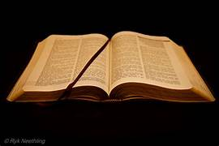
John 14:7-11
Radical Monotheism of the first century Jews makes the concept of Trinity difficult to understand.
Jesus and the Father are of one mind and one will.
If you see Jesus, you have seen God.
If you know Jesus you know God.
⁷ If you know me, you will know my Father also. From now on you do know him and have seen him.”
⁸ Philip said to him, “Lord, show us the Father, and we will be satisfied.”
⁹ Jesus said to him, “Have I been with you all this time, Philip, and you still do not know me? Whoever has seen me has seen the Father. How can you say, ‘Show us the Father’?
¹⁰ Do you not believe that I am in the Father and the Father is in me? The words that I say to you I do not speak on my own, but the Father who dwells in me does his works. ¹¹ Believe me that I am in the Father and the Father is in me, but if you do not, then believe because of the works themselves.
1
Notes:
Moses had asked to see the glory of God and he was refused. God would only let him see his backside as he walked away. Exodus 33.

Slide 13
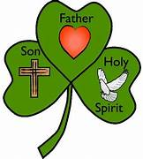
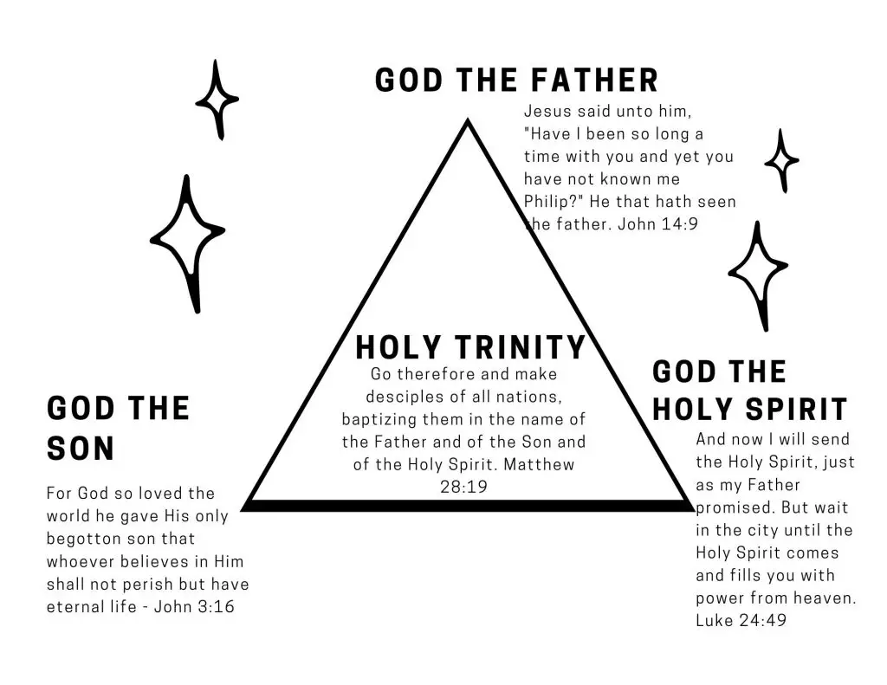
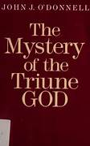
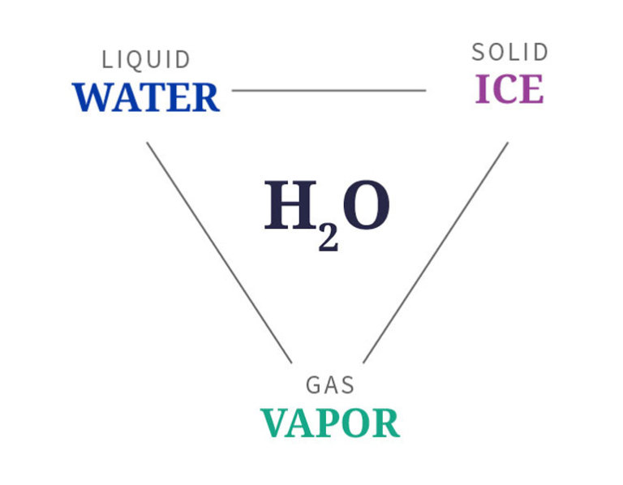

Slide 14
John 14:12-14
Greater works in numbers or quantity is meant here. What could be more amazing than raising someone from the dead?
Jesus is here for only a few years so his time and works are limited.
The name of Jesus is not a magical charm. Our prayers need to contribute to the glorification of the Lord. If prayers are unanswered, it might not be because of a lack of faith.
Prayers must be aligned with the mind and will of the Father. Our motives for asking are important.
¹² Very truly, I tell you, the one who believes in me will also do the works that I do and, in fact, will do greater works than these, because I am going to the Father.
¹³ I will do whatever you ask in my name, so that the Father may be glorified in the Son. ¹⁴ If in my name you ask me for anything, I will do it.
1
2
Notes:
1.Paul preached and taught and performed miracles for twenty years.
2. In prayer we call out to Jesus to fulfill His purpose not just to satisfy a whim. In Chapter 15 Jesus says it again. ⁷ If you remain in me and my words remain in you, ask for whatever you want and it will be done for you.
⁸ By this is my Father glorified, that you bear much fruit and become my disciples.

Slide 15
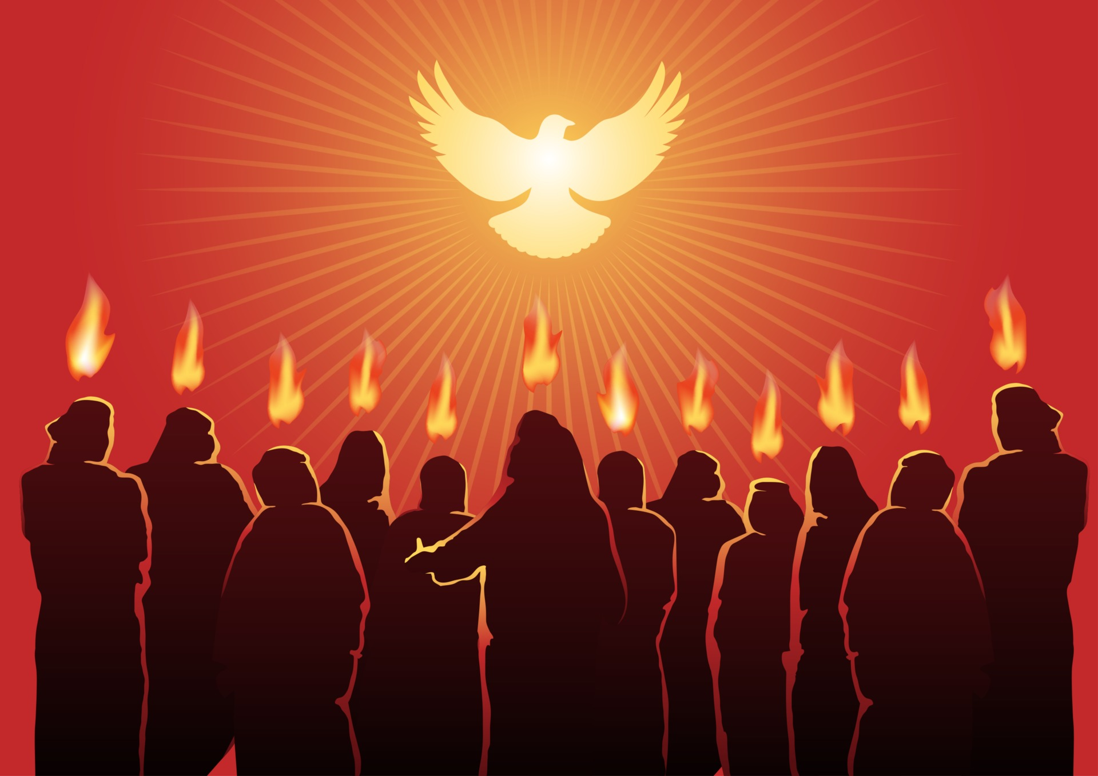
John 14:15-18
The Disciple’s obedience will be a reflection of their love of Jesus and the Father.
Jesus, the first “Advocate” will send a new permanent Advocate.
This Advocate is the in-dwelling Spirit of Truth, AKA The Holy Spirit.
Jesus shows his compassion and love for the disciples, who are going to face persecution and death for preaching the Good News of Jesus Christ.
¹⁵ “If you love me, you will keep my commandments.
¹⁶ And I will ask the Father, and he will give you another Advocate to be with you always, ¹⁷ the Spirit of truth, which the world cannot accept, because it neither sees nor knows it.
But you know it, because it remains with you, and will be in you. ¹⁸ I will not leave you orphans; I will come to you.
Notes:
He is not going to abandon them. He will empower them with the Holy Spirit and the Spirit will remain with them.

Slide 16
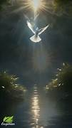
The Holy Spirit is eternal
Genesis 1:1-2
In the beginning God created the heavens and the earth. ² Now the earth was formless and empty, darkness was over the surface of the deep, and the Spirit of God was hovering over the waters.

Slide 17
John 14:19-21
“In a little while” refers to death and resurrection of Jesus.
Eternal life is made possible by the death and resurrection. Jesus rose and so will His believers.
On that day- (Easter), The Resurrection is the ultimate “Ah ha” moment. The message of Jesus becomes more clear.
1
2
¹⁹ In a little while the world will no longer see me, but you will see me, and because I live, you will live.
²⁰ On that day you will realize that I am in my Father and you are in me and I in you.
²¹ Whoever has my commandments and observes them is the one who loves me. And whoever loves me will be loved by my Father, and I will love him and reveal myself to him.”
Obedience is not an “option”. It is part of having a loving relationship with the LORD.
3
Notes:
1.These verses have multiple interpretations from the Biblical Scholars.
2.The World would not see Him again but Jesus appeared to the Apostles, to Mary and according to Paul’s letters to the Corinthians to more than 500 brothers.
3. On that day might also refer to the day of Pentecost when the Holy Spirit comes and teaches them everything. The HS remains with them, and dwells within the believers.
For the people of Israel, God seemed distant or remote but The Incarnation, when God became human, along with the in-dwelling Holy Spirit makes relationship with God a reality.

Slide 18
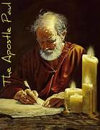
Paul’s teaching on the in-dwelling
Holy Spirit
^{1 Corinthians 3:16-17}
¹⁶ Do you not know that you are the temple of God, and that the Spirit of God dwells in you? ¹⁷ If anyone destroys God’s temple, God will destroy that person; for the temple of God, which you are, is holy.

Slide 19
John 14:22-24
Judas, son of James is listed as an apostle in Luke 16:6, and in Acts 1:13 his name is mentioned as one of those in the upper room before the Pentecost.
Acts 1:40-42
(Words of Peter)
⁴⁰ but God raised him on the third day and allowed him to appear, ⁴¹ not to all the people but to us who were chosen by God as witnesses and who ate and drank with him after he rose from the dead. ⁴² He commanded us to preach to the people and to testify that he is the one ordained by God as judge of the living and the dead.
²² Judas, not the Iscariot, said to him, “Master, [then] what happened that you will reveal yourself to us and not to the world?”
²³ Jesus answered and said to him, “Whoever loves me will keep my word, and my Father will love him, and we will come to him and make our dwelling with him. ²⁴ Whoever does not love me does not keep my words; yet the word you hear is not mine but that of the Father who sent me.
2
1
3
Notes:
1.Judas is asking why Jesus would not show himself to the entire world.
2.In the Gospels of Mark and Matthew, they call him Thaddeus. Acts 1: Peter describes the post resurrection appearances
3. If you do not keep Jesus’ words you are rejecting God.

Slide 20
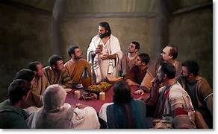
John 14:25-26
Just as Jesus demonstrated the personality and character of the Father to others, so too will the Holy Spirit make the living Christ real to His followers.
One of the functions of the Spirit is teaching and bringing meaning to the memories of their experiences with Jesus.
²⁵ “I have told you this while I am with you. ²⁶ The Advocate, the holy Spirit that the Father will send in my name—he will teach you everything and remind you of all that [I] told you.

Slide 21

John 14:27
The word used here is Shalom. The word is used 14 times in Exodus 21-22.
While peace is often used to indicate an absence of war or conflict, Christ’s “shalom” means, completeness, or general well being.
When used as a greeting it might mean “may your day be filled with inner rest and completeness where nothing is lacking.”
²⁷ Peace I leave with you; my peace I give to you. Not as the world gives do I give it to you. Do not let your hearts be troubled or afraid.
Notes:
Jesus is again trying to calm his disciples and remove their fears. They are worried about His leaving in the tension of the religious and political world they live in.
The Peace of Jesus is what you experience when you know you are in the presence of God and He is in control.

Slide 22
John 14:28-31
Rejoice- I’m going to The Father.
John 5:18 He is equal to the Father
He used the “I AM” title throughout the Gospel.
John 10:30 Jesus is one with the Father.
John10:38 He is in the Father and the Father is in Him.
John 14:9 If you see him, you have seen the Father.
One more prophecy- the betrayer is coming, prodded along by Satan
²⁸ You heard me tell you, ‘I am going away and I will come back to you.’ If you loved me, you would rejoice that I am going to the Father; for the Father is greater than I.
²⁹ And now I have told you this before it happens, so that when it happens you may believe.
³⁰ I will no longer speak much with you, for the ruler of the world is coming. He has no power over me, ³¹ but the world must know that I love the Father and that I do just as the Father has commanded me.
Get up, let us go.
1
2
3
Notes:
The word for love used in vs 28 is Agape. Agape love is the unconditional, selfless, and sacrificial love that God shows to us and that we are to show to others.
The phrase the Father is greater than I has been used by some heretical sects to suggest that Jesus is less than the Father or less than God. But scripture does not support that.
Here are a few of the verses in John where Jesus talks about the relationship of Father and Son.
2. At this point they do not understand everything. Some probably still think He would remain and be King.
3. In chapter 15 and 16 the dialogues in the upper room continue. This last phrase make biblical scholars believe that
This chapter is out of place. It sounds as if this should be place just before Judas turns Jesus over to the authorities.

Slide 23
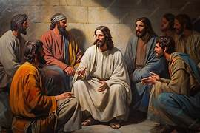
John 14
Verses to remember
“Do not let your hearts be troubled. You have faith in God, have faith in me as well”
“I am the Way, the Truth and the Life.”
“I will come again”
“Peace I leave with you; my peace I give to you. Not as the world gives do I give it to you. Do not let your hearts be troubled or afraid.”
“If you love me, you will keep my commandments.”

Slide 24
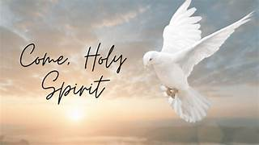
Holy Spirit,
I invite You into my heart and mind. Grant me the wisdom to discern Your voice amidst the noise of the world. Help me to recognize Your gentle nudges and clear direction.
In moments of confusion, be my compass. When faced with difficult choices, be my counselor. Guide my steps, my thoughts, and my actions, that they may align with Your perfect will.
Give me the courage to follow where You lead, even when the path seems challenging.
I ask you this in the name of Jesus Christ,
Amen

