Slide 1
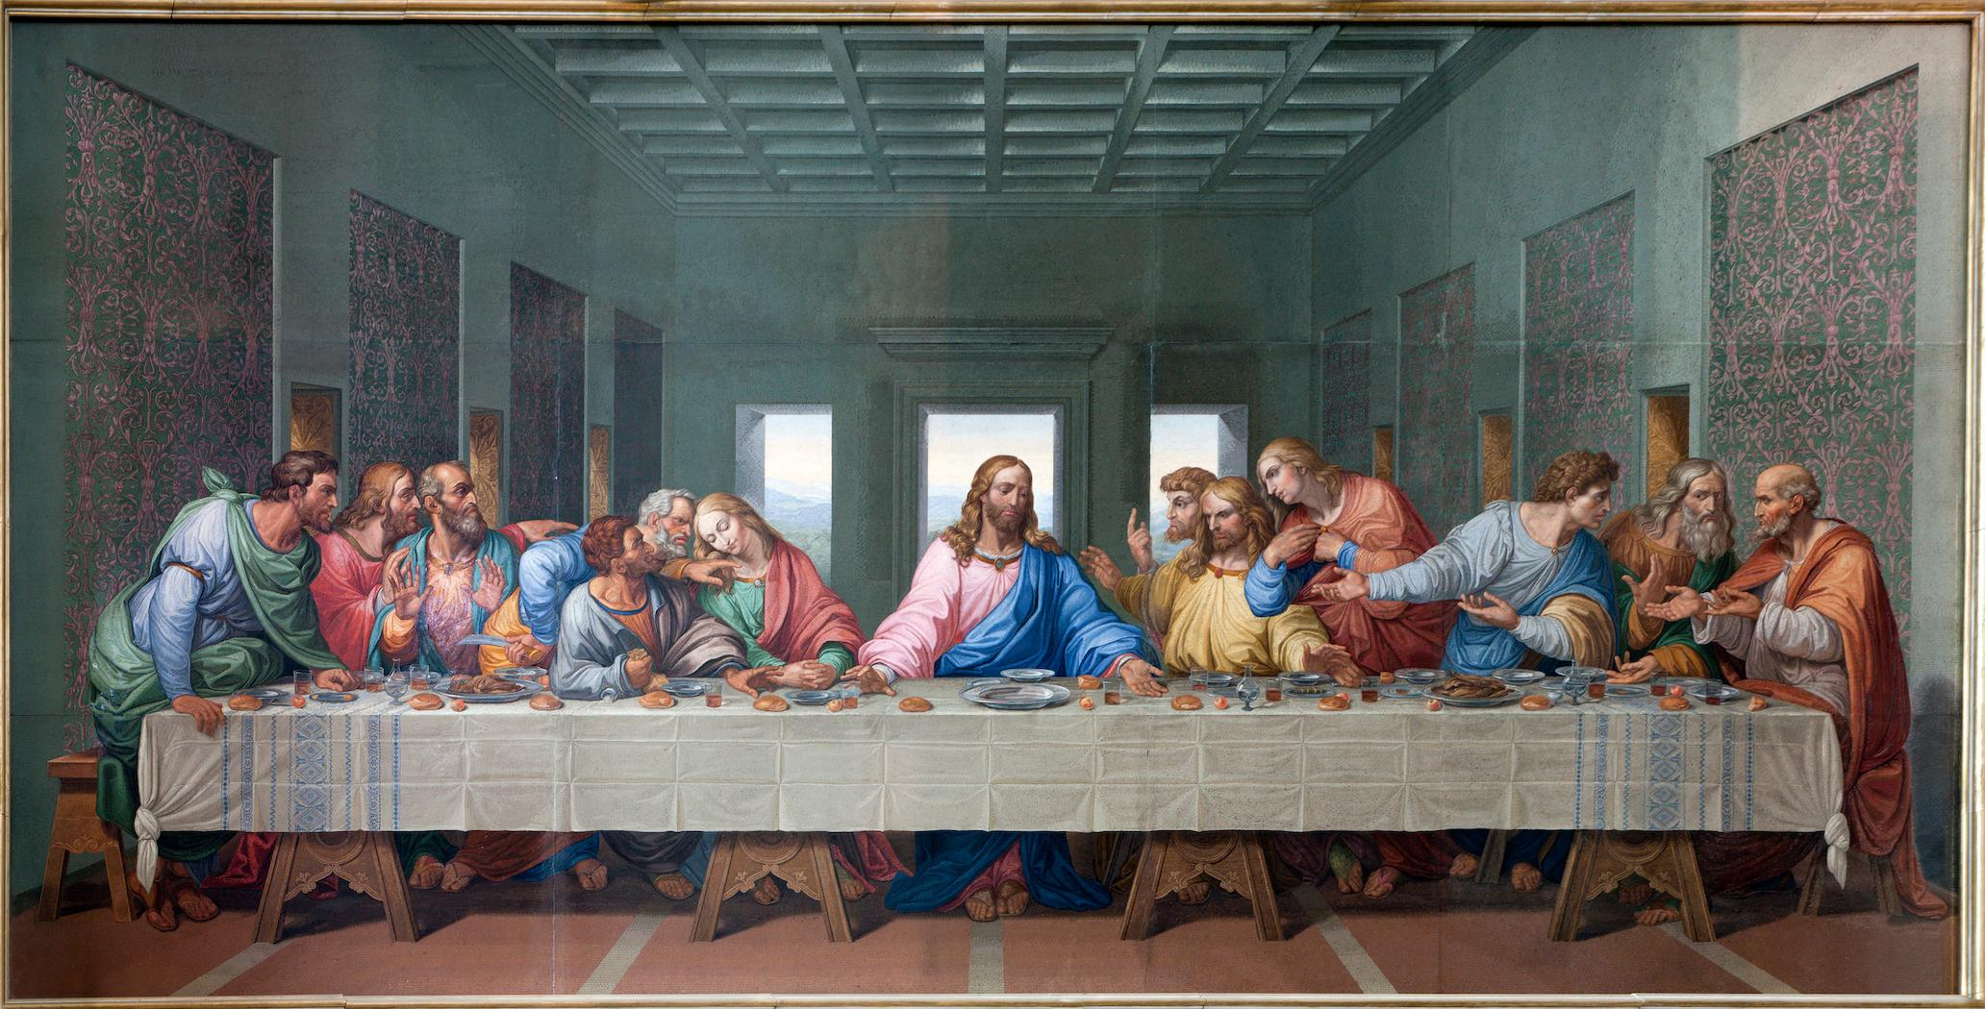

John 12:44-50 Judgement John 13:1-38 Last Supper

Slide 2
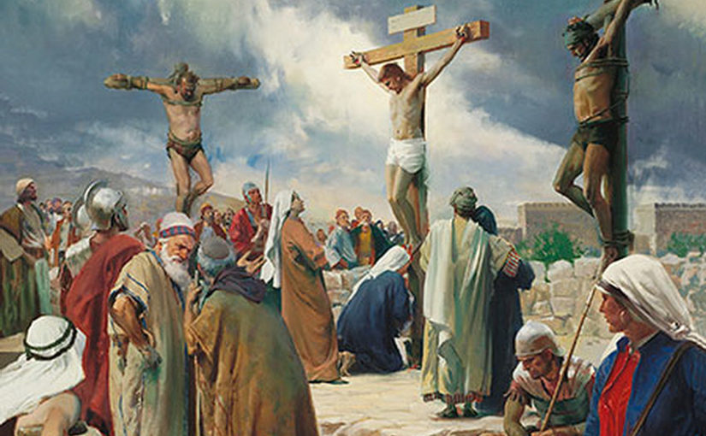
Summary of Jesus’ public ministry
Good Thief:
Remember me when you come into your kingdom (Lk. 23:42)
Jesus and the Father are one (Jn 12:44-45, 10:30)
Jesus is the Light of the World (Jn 12:46, 8:12)
Jesus came into the world to save not condemn (Jn 12:47, 3:17)
Every man’s response to Jesus ++ is His judgment (Jn 12:48, 3:18)
Jesus’ words come from the Father and bring eternal life (Jn 12:49-50, 8:28, 5:24)
Scoffers:
If you are the Son of God, come down from the cross! (Mt. 27:36)

Slide 3
Judgment Theme in John’s Gospel
CCC679. “Christ is Lord of eternal life.
Full right to pass definitive judgement on the works and hearts of men belongs to him as redeemer of the world.
He ‘acquired’ this right by his cross.
The Father has given ‘all judgement to the Son’. [Jn 5:22 ; cf. Jn 5:27 ; Mt 25:31 ; Acts 10:42 ; Acts 17:31 ; 2 Tim 4:1 .]
Yet the Son did not come to judge, but to save and to give the life he has in himself.[Cf. Jn 3:17 ; Jn 5:26 .]
By rejecting grace in this life,
one already judges oneself,
receives according to one’s works, [Belief]
and can even condemn oneself for all eternity by rejecting the Spirit of love. [ Jn 3:18 ; JN 12:48; Mt 12:32 ; 1 Cor 3:12-15 ; Heb 6:4-6 ; Heb 10:26-31 .]”

Slide 4
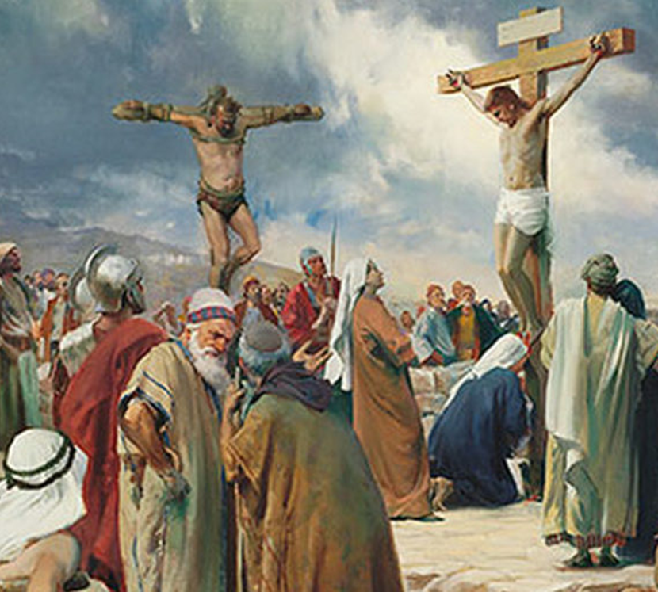
Let us beset the just one, because he is obnoxious to us; he sets himself against our doings, reproaches us for transgressions of the law and charges us with violations of our training. He professes to have knowledge of God and styles himself a child of the LORD. To us he is the censure of our thoughts; merely to see him is a hardship for us, because his life is not like other men's, and different are his ways. He judges us debased; he holds aloof from our paths as from things impure. He calls blest the destiny of the just and boasts that God is his Father. Let us see whether his words be true; let us find out what will happen to him. For if the just one be the son of God, he will defend him and deliver him from the hand of his foes. With revilement and torture let us put him to the test that we may have
proof of his gentleness and try his patience. Let us condemn him to a shameful death; for according to his own words, God will take care of him.“ These were their thoughts, but they erred; for their wickedness blinded them, And they knew not the hidden counsels of God; neither did they count on a recompense of holiness nor discern the innocent souls' reward. For God formed man to be imperishable; the image of his own nature he made him.
+
(Wisdom 2:12-23)

Slide 5
John 13:1-20

Slide 6
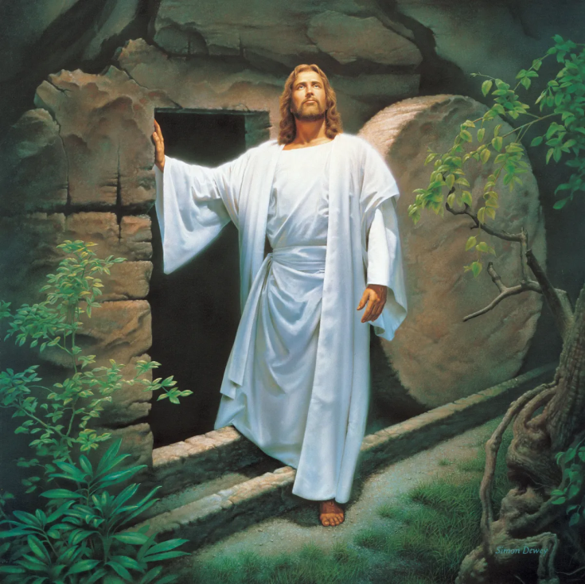
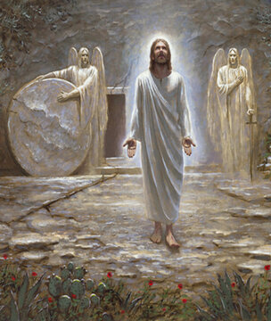

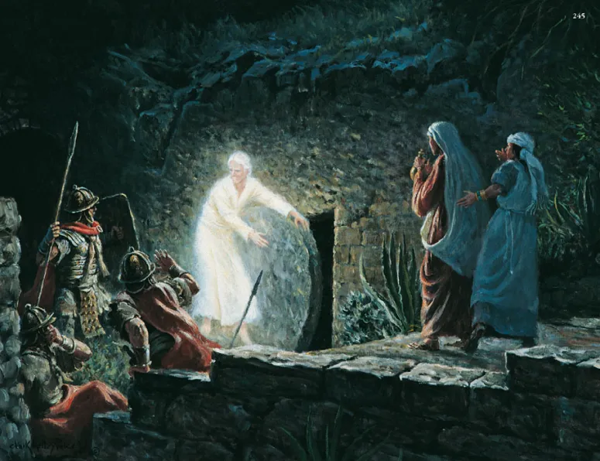
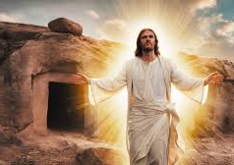
Book of Glory
Chapters 1-12 were the Book of signs
Public ministry
Revelatory signs and miracles
Chapter 13 begins a new theme in the Gospel
Theme of glorification
Chapters 13-17 are farewell discourses
Chapters 18-19 are the Passion
Chapter 20 is the Resurrection
Chapter 21 is the Epilogue
When angel opened Jesus’ tomb, soldiers were present, ladies came to anoint Jesus’ body, and tomb empty

Slide 7
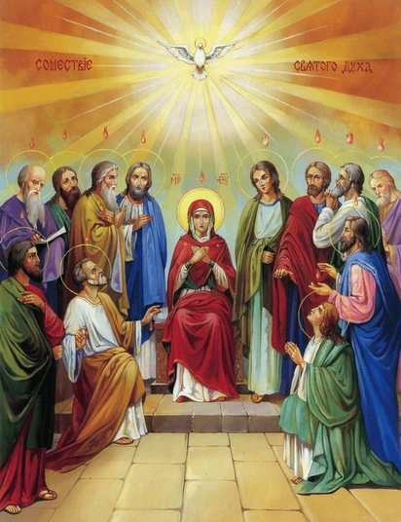

Farewell Discourse Jesus teaches His disciples
Of indwelling
But you know it, because it remains with you, and will be in you. (John 14:17)
Of love
I give you a new commandment: love one another. As I have loved you, so you also, should love one another. (John 13:10)
Of the Holy Spirit - Revealer
The Advocate, the Holy Spirit that the Father will send in my name--he will teach you everything and remind you of all that (I) told you. (Jn 14:26)
Advocate
I will ask the Father, and he will give you another Advocate to be with you always (John 14:16)
CCC246 The Latin tradition of the Creed confesses that the Spirit "proceeds from the Father and the Son (filioque)"

Slide 8
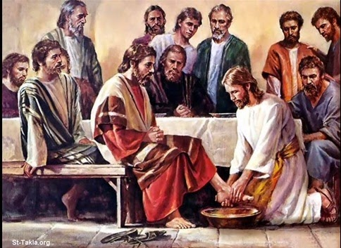
Character of Jesus
Jesus knew He was not far from the throne of God
He knew the power and glory that were His
He could have been filled with pride
He washed His disciples' feet
He had come from God and was going to God
He could have been filled with contempt for men
He knew He was about to be betrayed
He could have turned to bitterness and resentment
He knew who is betrayer was
He could have stopped him
"I am troubled now. Yet what should I say? 'Father, save me from this hour'? But it was for this purpose that I came to this hour.” (John 12:27)

Slide 9

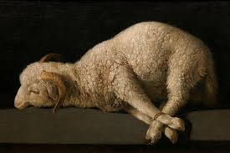
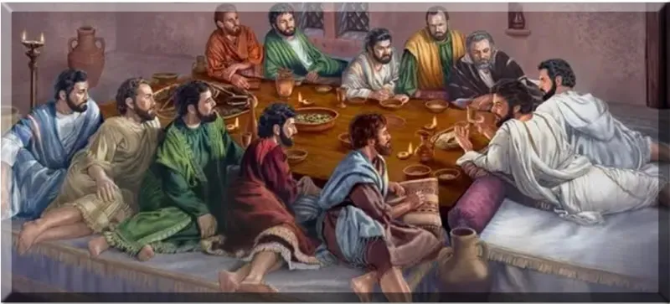
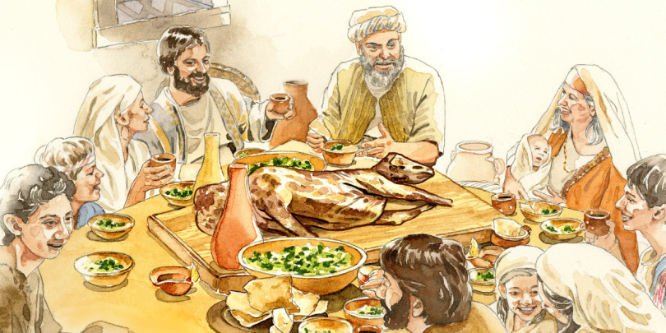
Meaning of Passover, H. pesah G. pascha
1. The Passover lamb which will be sacrificed and eaten during the feast
2. The Passover feast itself
3. The entire eight-day season of Passover including the Day of Unleavened Bread
4. In addition to the lamb sacrificed for the feast, additional lambs were also sacrificed on each of the eight days of the feast as peace offerings.

Slide 10
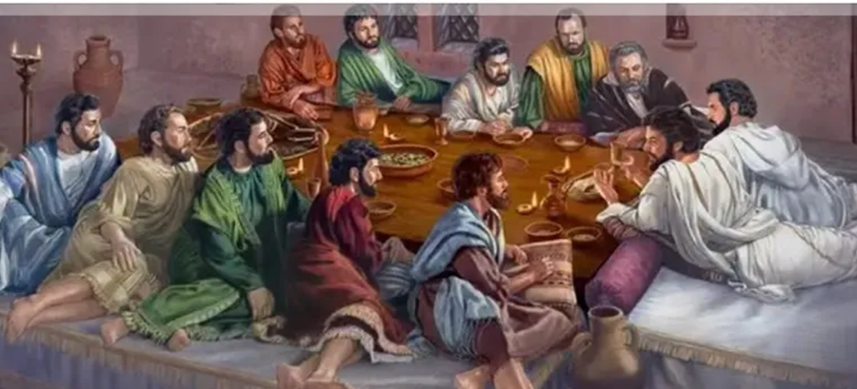
Before the Feast of Passover
Before the feast of Passover, Jesus knew that his hour had come to pass from this world to the Father. He loved his own in the world and he loved them to the end. The devil had already induced Judas, son of Simon the Iscariot, to hand him over. So, during supper, fully aware that the Father had put everything into his power and that he had come from God and was returning to God, he rose from supper and took off his outer garments. He took a towel and tied it around his waist. V.13:1-4
Before the feast of Passover can have different meanings depending on context
Any number of days before the feast
Immediately before eating the meal on the day of Passover
Context indicates immediately before eating the meal
Reclining was usual posture of Passover Meal, not daily meals
[Original Passover in Egypt, eaten standing]
Taking portion to the poor was Passover tradition.

Slide 11
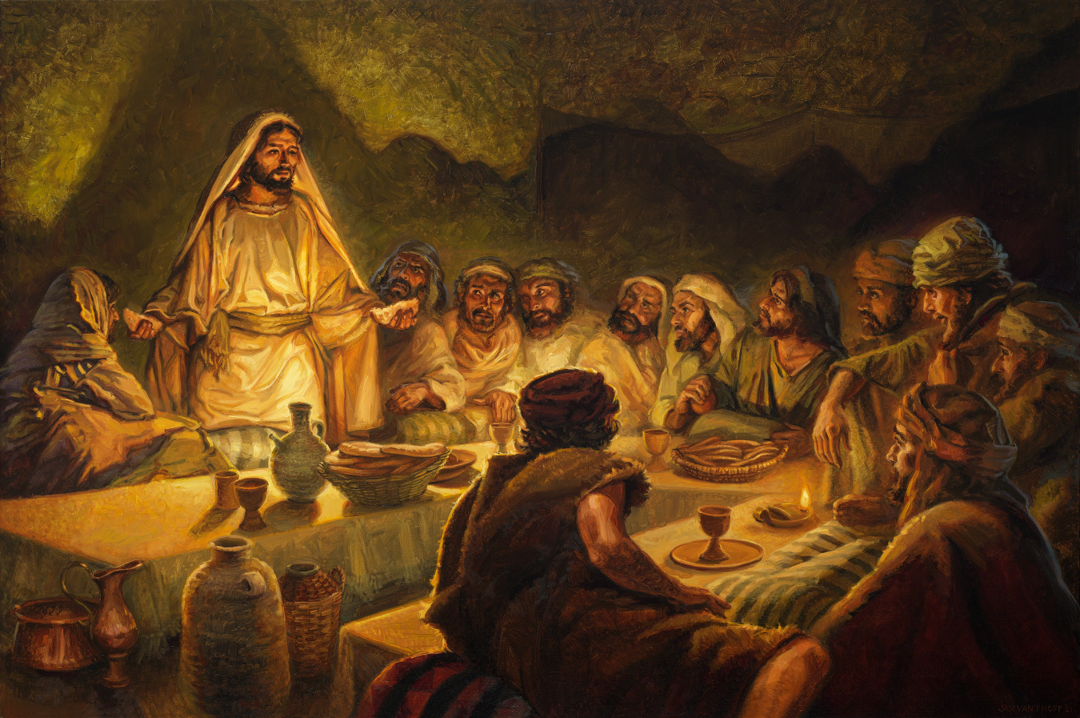
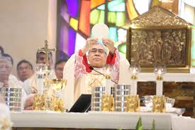
Church teaching on Last Supper
CCC1340 By celebrating the Last Supper with his apostles in the course of the Passover meal, Jesus gave the Jewish Passover its definitive meaning. Jesus' passing over to his father by his death and Resurrection, the new Passover, is anticipated in the Supper and celebrated in the Eucharist, which fulfills the Jewish Passover and anticipates the final Passover of the Church in the glory of the kingdom.

Slide 12
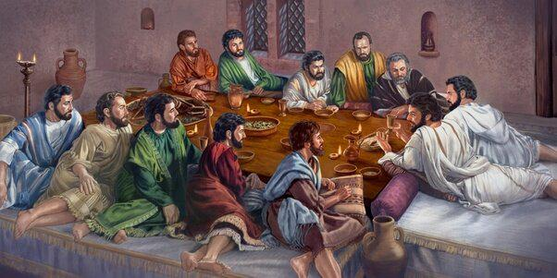
Synoptic Gospels identify Last Supper as Passover
Fn. SIB. 13:2 during supper: The Synoptic Gospels specify that it was a Passover meal
Matthew 26:19
The disciples then did as Jesus had ordered and prepared the Passover. (Matthew 26:19)
Mark 14:16
The disciples then went off, entered the city, and found it just as he had told them; and they prepared the Passover.
Luke 22:15-16
He said to them, "I have eagerly desired to eat this Passover with you before I suffer, for, I tell you, I shall not eat it (again) until there is fulfillment in the kingdom of God."

Slide 13
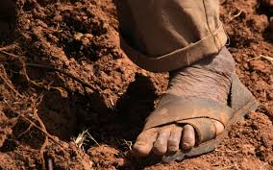
Foot Washing
Roads in Israel were not surfaced and were unclean
In dry weather – very dusty
In wet weather – liquid mud
Sandals were the usual footwear
Great water pots stood at the entrance to homes
Servant held an ewer and towel for guests
Foot washing was a slave’s duty
Rabbi’s disciples rendered personal service
Foot washing was below the station of a disciple

Slide 14
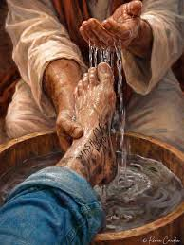
Foot washing
Not reported in the Synoptic Gospels
John’s Gospel omits the institution of the Eucharist at the Last Supper
Addressed in Chapter 6
John’s Gospel
Does not repeat what was known from the other Gospels
Focuses on the significance of the Gospel stories
Fills in gaps
Other reasons
Luke and Mark, not apostles
Shielded Apostles from describing this lowly slave duty
Matthew space issues?
According to Eusebius
First Gospel, ~49 AD, originally, in Hebrew, quicky translated to Greek
She will bear a son and you are to name him Jesus [H. Jehoshua], because he will save his people from their sins.“ (Matthew 1:21)
Jesus doesn’t mean that in Greek. Jehoshua does in Hebrew.
Mark wrote Paul’s Gospel which Paul received from Risen Christ
Luke wrote Peter’s Gospel

Slide 15
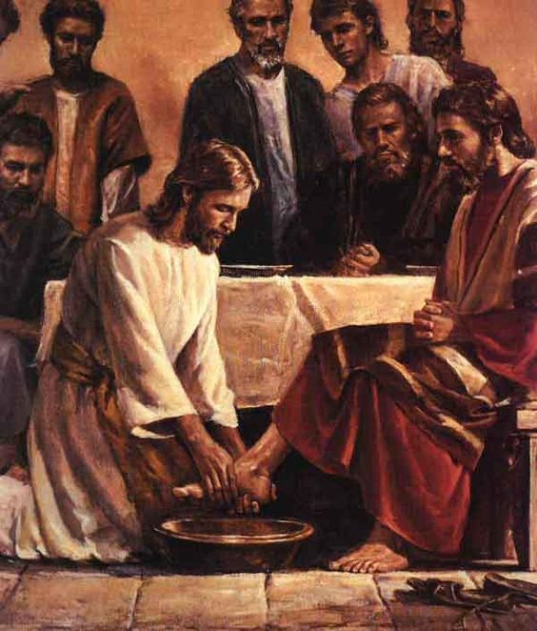
Significance
Servant foot washing symbolic of Jesus’ servant death.
Though he was in the form of God, did not regard equality with God something to be grasped. Rather, he emptied himself, taking the form of a slave. ( Philippians 2:6-7)
Consider the verbs:
Jesus laid aside his garments and takes them up again.
This is why the Father loves me, because I lay down my life in order to take it up again. (John 10:17)
The theme of the story is cleansing
"Unless I wash you, you will have no inheritance with me." (John 13:8)
There is no place in the fellowship of Christ without being cleansed by the blood of Jesus.
The blood of his Son Jesus cleanses us from all sin. (1 John 1:7)

Slide 16
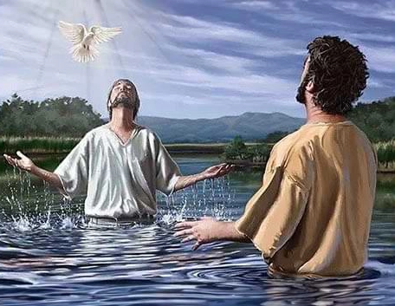
Need for cleansing Jesus said to him, "Whoever has bathed has no need except to have his feet washed, for he is clean all over; (John 13:10)
Whoever has bathed
Reference to Baptism
Except to have his feet washed
Curious phrase
Cambridge Commentary (Anglican) explains it:
“So, the disciples, already cleansed by their fellowship with Christ, need only to have their slighter faults removed.”
Sounds like:
Reconciliation
Purgatory

Slide 17
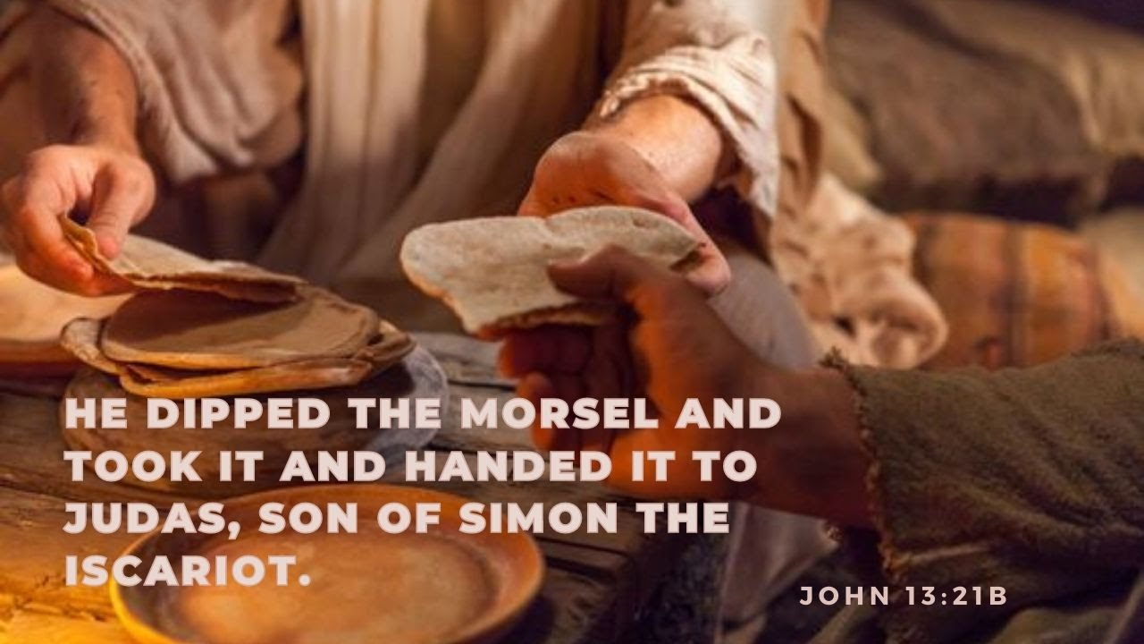
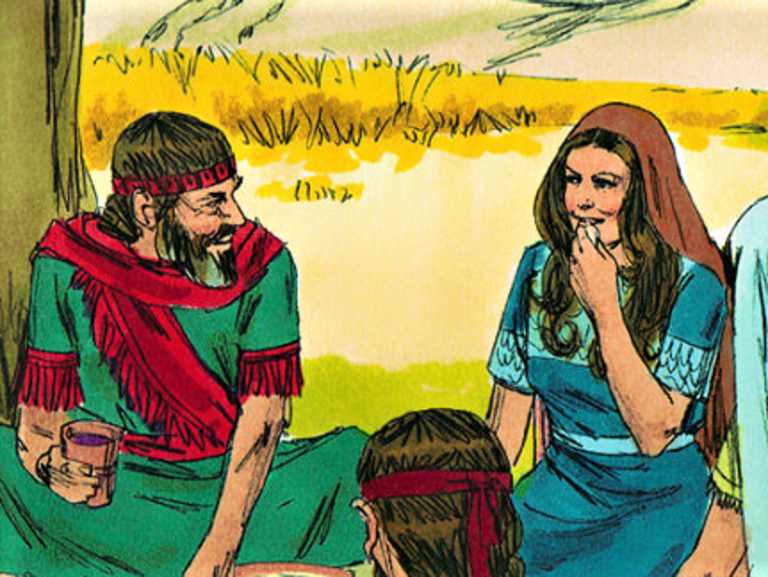

Judas
Judas was an actor and a hypocrite
His plans for betrayal were made
His betrayal was deliberate
His actions and manner deceived the disciples
His heart was bare to Jesus
Judas sat at the place of honor
Left side of host was the place of honor
Judas rejected Jesus’ appeal of friendship
Offering a morsel from the dish was a sign of special friendship
Boaz wished to honor Ruth – invited her to dip her morsel in the wine (Ruth 2:14)
Warning to us. We can deceive the world, but we cannot hide our hearts from Jesus.

Slide 18
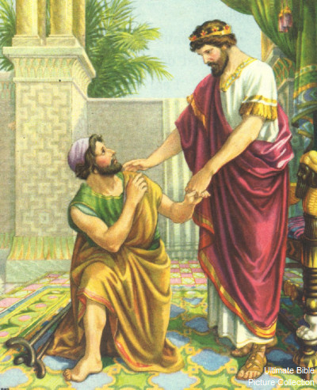
Mark of Friendship
Sharing bread was a mark of friendship
David grants Mephibosheth, descendant of Saul, to eat bread at his table (1Kg 18:19)
Disloyalty of a friend is the bitterest hurt
“If an enemy had reviled me, that I could bear; If my foe had viewed me with contempt, from that I could hide. But it was you, my other self, my comrade and friend,” (Psalm 55:12-14)
“Yea, my own familiar friend, in whom I trusted, which did eat of my bread, has lifted up his heel against me.” (Ps 41:9)
Lifting the heel implies being kicked violently as by a horse.
Appeal to Judas
Wanted disciples to know
Not caught in circumstances
He was not going to be killed
He was giving up His life

Slide 19
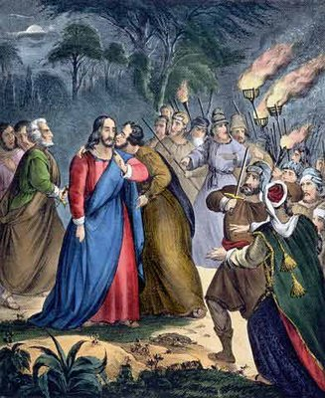
Jesus’ response to His betrayer
Gave Judas every opportunity to repent
Jesus washed his feet
Reproved him without bitterness
Censured him in private
Ministered to him
Allowed him to share his table
Allowed him a kiss
Jesus was deeply troubled
Jesus was deeply troubled and testified, "Amen, amen, I say to you, one of you will betray me." (John 13:21)
Troubled in the Spirit, moved by the deepest emotions (John 11:33)
(Jesus hearing of Lazarus death)
Jesus loved His enemy

Slide 20
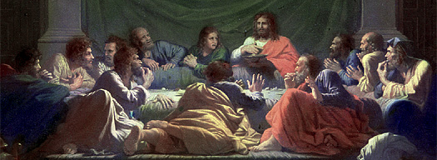
Seating
Table was a low solid block
Couches were set around the table
Shaped like a U
Place of honor – host – at the short side
All reclined on the left side
Jesus could talk privately to Judas
Disciple Jesus loved was on His right
Reclined his head on Jesus’ breast
Judas already left

Slide 21
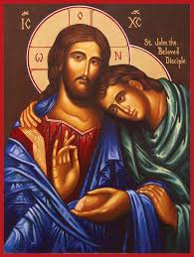
Disciple whom Jesus loved
Never named
May have been Lazarus
Jesus loved Lazarus (Jn 11:36)
May have been the rich ruler
Jesus loved him (Mk 10:21)
May have be generic picture of disciple
Picture of what a disciple should be
May have been John
Generally accepted conclusion

Slide 22
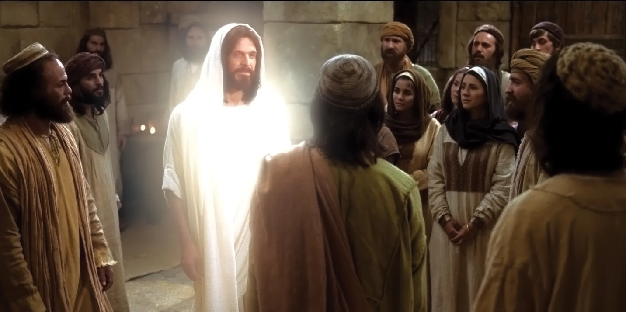
Double meanings
He loved them to the end. V.1
In time - throughout eternity
In measure - completely without reservation
It was night. V.30
The sun had gone down in the evening
Judas had rejected Christ to betray Him
Darkness of a Christless life
Judas deserts the “Light of the World”
Passes from light into darkness

Slide 23
Love One Another As I have loved you, so you also should love one another. (John 13:34)
Love your neighbor was an Old Testament admonition
Take no revenge and cherish no grudge against your fellow countrymen. You shall love your neighbor as yourself. I am the LORD. (Leviticus 19:18)
This was oriented toward fellow Jews (countrymen).
In the sermon on the Mount, Jesus extended the commandment to include enemies
"You have heard that it was said, 'You shall love your neighbor and hate your enemy.' But I say to you, love your enemies, and pray for those who persecute you, (Matthew 5:43-44)
There is no explicit command to hate your enemy.
Do I not hate, LORD, those who hate you? Those who rise against you, do I not loathe? With fierce hatred I hate them, enemies I count as my own. (Psalm 139:21-22)

Slide 24
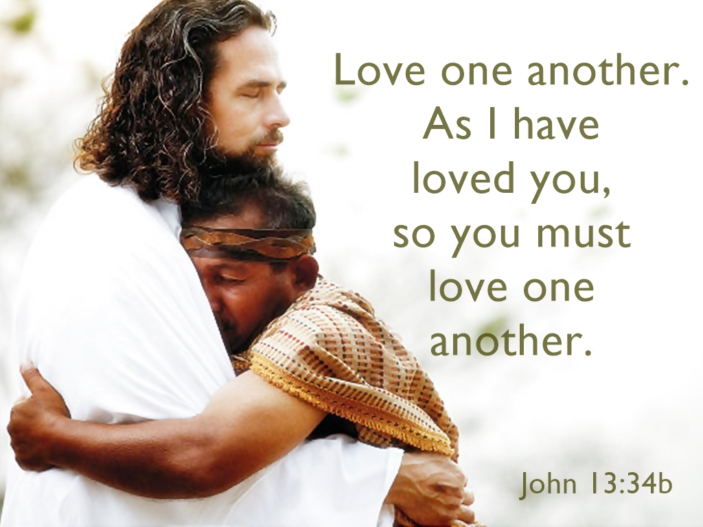
Love One Another V.34-35
I give you a new commandment: love one another. As I have loved you, so you also should love one another. This is how all will know that you are my disciples, if you have love for one another.“ V.34-35
Jesus has assumed the prerogatives of God
He has judged and He has forgiven sins.
He has shown mastery of the elements of nature.
He has given life to the dead.
He has given definitive interpretations to Gods laws
Now Jesus assumes the Godly role of lawgiver
God had given the Law to Moses.
The 10 commandments were to guide the actions of the Jews in their daily lives.
Now Jesus gives the new Law to His followers
It fully embodies the Law of Moses
It will be the preeminent guide to the Church
It is our principal guide to living

Slide 25
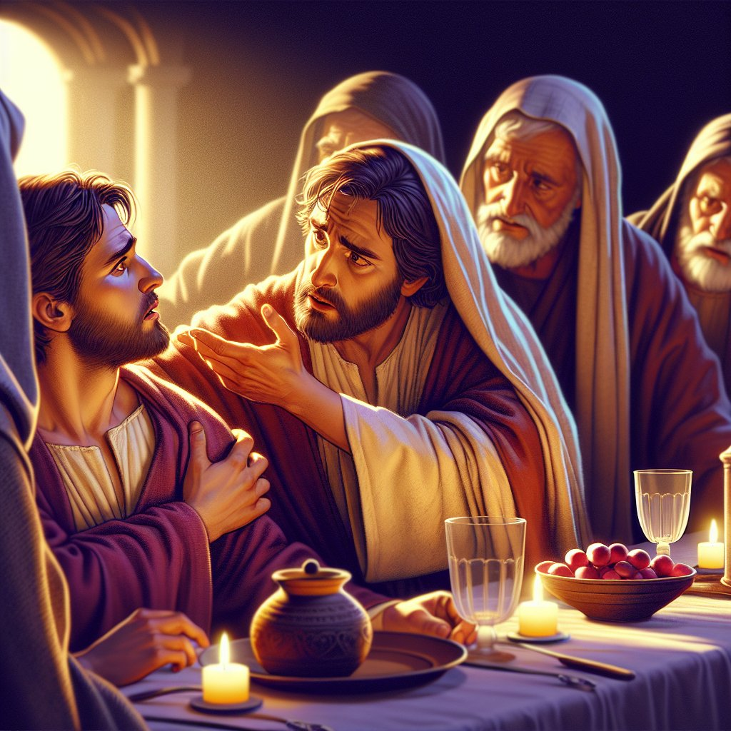
Last words of Jesus public ministry
Simon Peter said to him, "Master, where are you going?" Jesus answered (him), "Where I am going, you cannot follow me now, though you will follow later.“ Peter said to him, "Master, why can't I follow you now? I will lay down my life for you.“ Jesus answered, "Will you lay down your life for me? Amen, amen, I say to you, the cock will not crow before you deny me three times.“
(John 13:36-38)

Slide 26
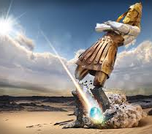
Jesus’ Words Fulfilled
Jesus will go to the cross
Peter will be the rock that establishes the head of the Church in Rome
Fulfilling the prophecy of Daniel
In the lifetime of those kings the God of heaven will set up a kingdom that shall never be destroyed or delivered up to another people; rather, it shall break in pieces all these kingdoms and put an end to them, and it shall stand forever. That is the meaning of the stone you saw hewn from the mountain without a hand being put to it, which broke in pieces the tile, iron, bronze, silver, and gold. The great God has revealed to the king what shall be in the future; this is exactly what you dreamed, and its meaning is sure.“ (Daniel 2:44-45)
Peter will go to the cross upside down

Slide 27
